Slide 1
NEON 2023
Alice K. Gong, M.D.
WILLIAM AND RITA HEAD DISTINGUISHED CHAIR IN DEVELOPMENTAL AND ENVIRONMENTAL NEONATOLOGY
Professor of Pediatrics
Joe R. and Teresa Lozano Long School of Medicine
UT Health San Antonio

Slide 2

Voluntary, regional, working group of collaborators
Ensure children born premature and sick can reach their maximal potential
Follow-through care that is high quality, comprehensive, evidence-based
Develop and foster standardized guidelines to lead follow-through care
Inform policies to benefit families traumatized by children born premature and sick.

Slide 3
9th summit
20 Feb. 2015
San Antonio
19 Feb. 2016
Fort Worth
10 Feb. 2017
Houston
9 Feb. 2018
Temple
8 Feb. 2019
San Antonio
26 Feb. 2019
Austin, TCHMB pre-conference
26 Feb. 2020
Austin, TCHMB
11 Feb. 2021
virtual, TCHMB
16 Feb. 2022
virtual, TCHMB

Slide 4
Summit 1
Initiate dialogue about follow-through practices
Feasibility of developing a working group focused on long-term outcomes
Feature speaker - Dr. Tonse Raju, branch chief, pregnancy and perinatology branch, Eunice Kennedy Shriver National Institute of Child Health and Development
Involved academic and private practice programs, Early Childhood Intervention, parent advocates, therapists
Publication: Newborn Intensive Care survivors: a review and plan for collaboration in Texas

Slide 5
Hosted by Dr. Yvette Johnson, medical director, Cook Children’s N.E.S.T. development follow-up center.
Featured Dr. Betty Vohr, Albert Medical School, Brown University.
Small groups met to discuss identifying performance measures, data points, interventions, outcomes in areas of advocacy/policy, parental involvement, post-discharge nutrition, standardization of developmental testing, clinic coordination.
Dr. Allison Dempsey, UT Houston Memorial Children’s Hospital
Dr. Barbara Deloian, president, CEO, Special Kids/Special Care, CO
Summit 2

Slide 6
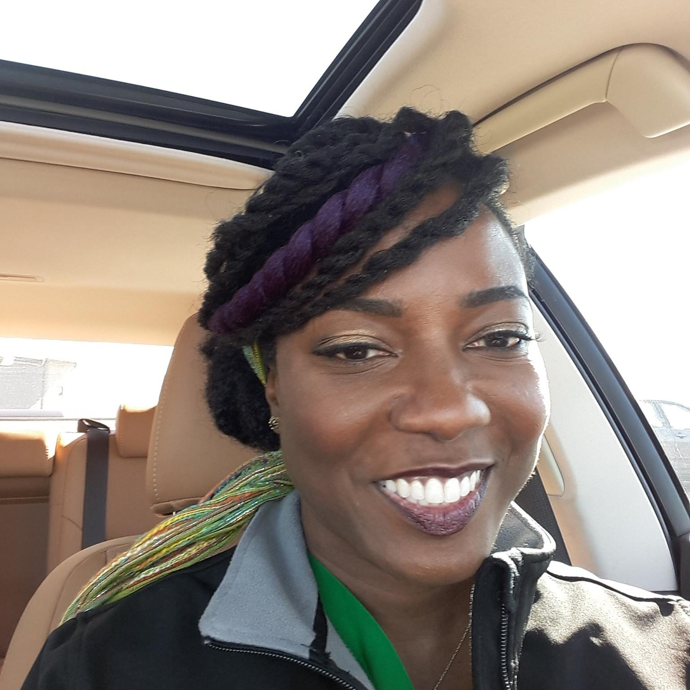
Summit 3
Hosted by Dr. Andrea Duncan, medical director, Neonatal High-Risk clinic, Tiny Tot Clinic for neurodevelopmental and behavioral health.
Speakers:
  Glen Aylward, PhD
  Susan Hintz, MD, MSepi (CA collaborative)
  Martha Welch, MD
  Alice Gong, MD
NEON website launched

Slide 7
Summit 4
Hosted by Dr. Niraj Vora and Martha Hemingway, McLane Children’s Hospital
Featured speaker, Dr. Nathalie Maitre, Director NICU follow-up clinic, Nationwide Children’s Hospital on early CP diagnosis
Other speakers:
  Dr. Audelio Rivera, results of 2017 NEON survey
  Dr. Ann Stark, medical director, AAP NICU verification program
QI project identified – collect baseline data from 2017 on timing of diagnosis of CP; change first follow-through appointment to 3-4 months to work towards early CP diagnosis

Slide 8
Summit 5
Co-hosted by Dr. Alice Gong, medical director, Premiere clinic and Dr. Christine Aune, medical director, Pediatrix-San Antonio Developmental Pediatric Clinic
Feature speaker: Dr. David Lakey, Vice Chancellor for Health Affairs and Chief Medical Officer, University of Texas System
First family perspective of NICU care and follow-through, moderated by Dr. Mario Fierro
Other speakers:
  Carol Baisden, OTR, quality assurance therapist consultant, ECI
  Rachel Byrne, PT, vice president of programs, Cerebral Palsy Foundation
Hammersmith Infant Neurologic examination training (HINE) by Dr. Andrea Duncan and Rachel Byrne.

Slide 9
Summit 6
First joint meeting with TCHMB
Featured speakers
  Dr. Jan Brunstrom-Hernandez on cerebral palsy experiences
  Dr. Nathalie Maitre on interventions to promote neurodevelopmental recovery in high-risk infants
Neon members presented on status of CP diagnosis in their clinics
  Dr. Cathi Roberts, Dr. Mario Fierro and Dr. Christine Aune, Dr. Roy Heyne, Dr. Yvette Johnson, Dr. Alice Gong, Dr. Sydney Kometani

Slide 10
Summit 7, virtual
Featured speakers:
  Maja J. Mataric, PhD, Chan Soon-Shiong Chair and distinguished professor of computer science, neuroscience, and pediatrics, Biterbi School of engineering, USC.
  Thubi Kolobe, PT, PhD, FAPTA, University of Oklahoma
  Dr. Yvette Johnson presented the newly published International Guidelines for early CP diagnosis and follow-up
Premature born twins gave their perspectives and shared their journey
Early CP diagnosis – QI project

Slide 11
Summit 8
Focused on transition to school
Featured speaker: Dr. Andrea Duncan, MD, MSClinRes spoke on school readiness in children with disabilities
Family panel video recorded by Alicia Quim, BA-CCM on 3 families and their journey to enter school systems.
Sara Sifford, MS, LSSP, coordinated a presentation by educators: JoAnna Perez, LSSP, Laureen Owen, M.ED., and Barbara Triplett, M.ED.
Rachel Byrne, PT presented on evidence base therapy for children with CP
Madison Paton, PhD, research fellow at Cerebral Palsy Alliance Research Institute, Sydney, NSW, AU, presented status of stem cell research for CP

Slide 12

State of Texas NICU Follow-Up
Thanks to:
Matthew Rysavy, MD, PhD
Yvette Johnson, MD, MPH
Kristine Tolentino-Plata, MS
And Crystal Smith for the reminders
2023

Slide 13
Notes:
Abstract: Objective: The impact of the COVID-19 pandemic on the functioning and services of aca-demic high-risk infant follow-up (HRIF) clinics throughout North America. Study Design: Prospec-tive 25-question questionnaire survey through REDCAP links that was sent over 10 weeks, to 105 US and 10 Canadian programs. Finally, 59 of 105 US programs and 5 of 10 Canadian responses were analyzed using SAS version 9.4. Results: In the US, 67% of programs reported closures between 1–5 months, whereas in Canada 80% of programs closed for 1–3 months. In the US 86% of programs provided telemedicine visits and only 42.5% provided multidisciplinary HRIF telemedicine visits. We enumerated innovative approaches speciﬁcally for the conduct of Telemedicine visits, the need for the standardization of various tests and services in a telemedicine setting, and to emphasize the urgent need for more government funding to improve follow-up and developmental services to this fragile group of newborns.

Slide 14
Responding Sites (n=10) and Patient Panel Size
Premiere Clinic (San Antonio) — 400
McLane Children’s Specialty Clinic (Temple) — 400
Pediatrix Tots Clinic (Dallas) — 500
San Antonio Pediatric Developmental Clinical (San Antonio) — Thousands
BSW Follow-up Clinic (Temple) — 600
NEST Developmental Follow-up Clinic (Fort Worth) – 2700
DCH High Risk Follow-up (Corpus Christi) – 1900
THRIVE Clinic (Dallas) – 1350
UT Physicians Infant and Children’s High-Risk Clinic (Houston) – 300
Texas Tech Pediatric High-Risk Clinic (El Paso) – 200
*Models include single-center and multi-center catchment

Slide 15
Eligibility for Follow-up Clinic
Birthweight criteria:
7 sites with BW criteria
7 sites BW ≤1500 g
3 sites without BW criteria
2 use only gestational age criteria
1 based on NICU utilization (NICU stay >10 d)
Gestational age criteria:
8 sites with GA criteria
3 sites <34 weeks
4 sites <32 weeks
1 site <30 weeks
2 sites without GA
1 uses only BW criteria
1 based on NICU utilization (NICU stay >10 d)

Slide 16
Additional Referral Criteria
Other criteria listed:
Syndromes or metabolic/congenital/chromosomal disorders associated with developmental delay (n=4)
Double volume exchange transfusion
NEC (stage II or greater; bowel resection) (n=2)
iNO
Severe BPD

Slide 17
Specialty of Individual Running Follow-Up Clinic
*1 clinic with co-direction by Developmental Pediatrics and Neonatology

Slide 18
Clinic Personnel
Neonatologists involved in outpatient follow-up at 8 clinics
  4 clinics involve a primary neonatologist from inpatient team
Other specialists:
  7 involve nutritionist/dietician
  7 involve social work/case management
  5 involve psychologist
  4 involve PT/OT
Other personnel include a variety of pediatric subspecialties, a parent support liaison, lactation support, respiratory therapy, speech therapy

Slide 19
Visit Timing
First visit varied from:
1-2 weeks after discharge: 5 clinics
4 weeks after discharge: 1 clinic
10-12 weeks after discharge: 4 clinics
Last routine visit varied from:
2-3 years’ age: 4 clinics
5-6 years’ age: 5 clinics

Slide 20
Routine Follow-Up Tests/Exams
  Administered routinely in 8 clinics
Bayley Scales of Infant and Toddler Development (BSID)
Hammersmith Infant Neurological Exam (HINE)
  Administered in 7 clinics
  Start times vary:
    9-12 months: 4 clinics
    18 months: 2 clinics
    20 months: 2 clinics
  Repetition varies:
    5 clinics repeat over 1-2 years
    2 clinics with single exam
  Administered routinely in 2 clinics
General Movements Assessment (GMA)

Slide 21
Additional Details
1 clinic performs home visits (infrequently)
3 clinics served as medical homes
  These 3 included a 24/7 call line for patients
9 clinics managed post-discharge nutrition/growth
6 clinics provided screening or referral for parental mental health
  1 clinic also integrated parental mental health support

Slide 22
Neon executive committee wishes to continue to collect this information so that we can all have access to a comprehensive list of all the follow-through programs for high-risk neonates in Texas.

Slide 23
ECI survey
Rationale:
  We have all heard incidences from other providers and patients as to the problems that they have had with Texas Early Childhood Intervention,
  State ECI have been invited to share their process so we can understand how to get therapy for the at-risk children
  Infants found to be moderate to severely impaired by standardized testing are turned down for services due to not meeting criteria as determined by ECI testing
  Parental report of being ask if they had concerns about their child as a screening question.
  We wanted to survey how the patients from developmental follow-through programs are faring with regard to Texas ECI referrals
  Survey still in progress, this is a preliminary report.
  Lessons learned to be shared

Slide 24
ECI Survey Results
197 Total Responses
Date Created: May 26, 2022
Date data queried: February 09, 2023
Many thanks to Dr. Christine Aune and LeAnna Brooks, Pediatrix, San Antonio for hosting the site, collecting and sharing findings

Slide 25
Q1: Which developmental clinic location did you attend today?
Answered: 197 Skipped: 0
ANSWER CHOICES | RESPONSES
San Antonio Pediatric Developmental Services, 5430 Fredericksburg Rd Ste 508 San Antonio, TX 78229 | 49.75% | 98
Developmental Medicine of Dallas, 12655 N Ctrl Expressway, Ste 300 Dallas, TX 75243 | 0% | 0
Preemie Place South, 7400 Fannin St, Houston, TX 77054 | 0% | 0
University Health, 4502 Medical Dr. San Antonio TX 78229 | 41.62% | 82
Cook Children's NEST Developmental Follow Up Clinic, 1521 Cooper St. Fort Worth, TX 76104 | 4.57% | 9
Driscoll High Risk Follow-Up, Corpus Christi, TX | 0% | 0
Thrive Clinic (UTSW), Dallas, TX | 4.06% | 8
Other (please specify) | 0% | 0
TOTAL |  | 197

Slide 26
Q2: Gestational age:
Answered: 193 Skipped: 4

Slide 27
Q3: Birthweight:
Answered: 187 Skipped: 10
ANSWER CHOICES | RESPONSES
<500 grams (<17.64 oz) (P07.0) | 1.60% | 3
501-750 grams (1.10-1.65 lb) (P07.0) | 6.42% | 12
751-1000 grams (1.65-2.20 lb)(P07.0) | 12.83% | 24
1001-1250 grams (2.21-2.75 lb) | 8.56% | 16
1251-1500 grams (2.76-3.30 lb) | 11.76% | 22
1501-2000 grams (3.31-4.41 lb) | 20.86% | 39
2001-2500 grams (4.42-5.51 lb) | 8.56% | 16
>2501 grams (>5.52 lb) | 29.41% | 55
TOTAL |  | 187

Slide 28
Q4: Ethnicity:
Answered: 197 Skipped: 0
Notes:
Hispanic 70%

Slide 29
Q5: Primary language :
Answered: 196 Skipped: 1
Notes:
Additional responses include: American Sign Language, Urdu and Pashto

Slide 30
Q6: Race:
Answered: 192 Skipped: 5

Slide 31
Q7: Primary insurance:
Answered: 195 Skipped: 2

Slide 32
Q8: Place of primary residence :
Answered: 186 Skipped: 11
ANSWER CHOICES | RESPONSES
Urban | 33.87% | 63
Suburban | 56.45% | 105
Rural (<2500 population) | 9.68% | 18
TOTAL |  | 186

Slide 33
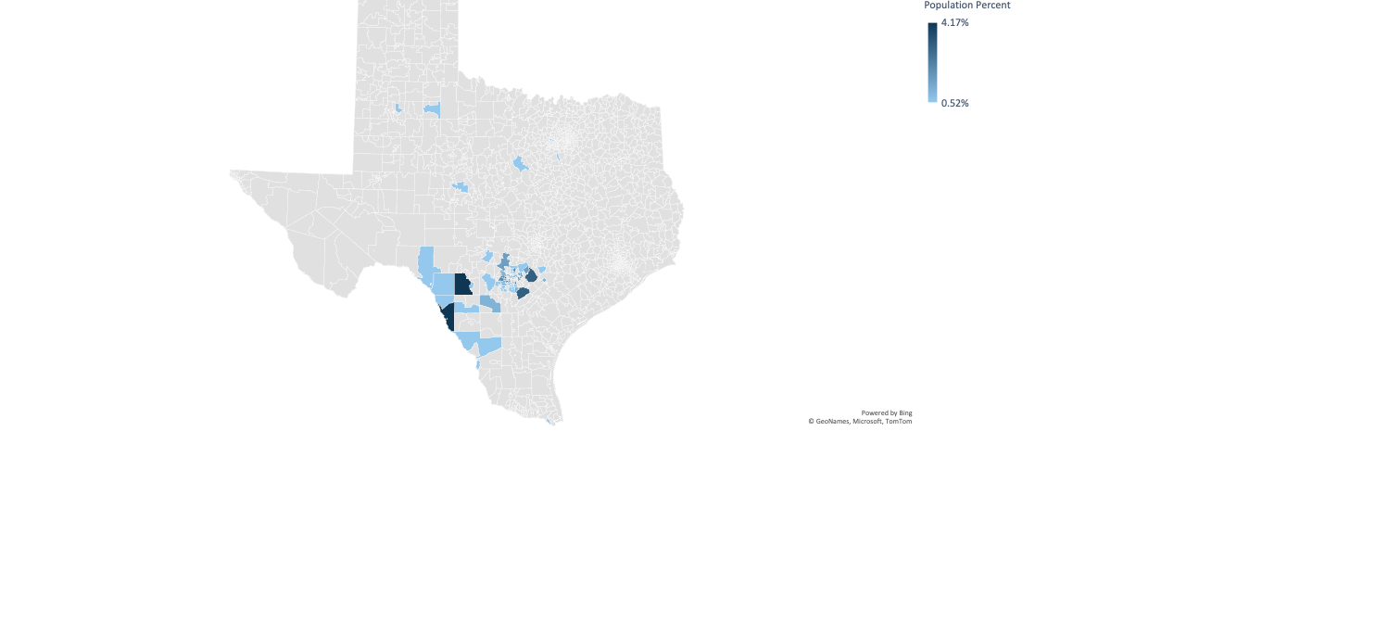
Q9: Zip Code:
Answered: 192 Skipped: 5

Slide 34
Q10: Diagnosis: (Check all that applies):
Answered: 126 Skipped: 71

Slide 35
Q10: Diagnosis: (Check all that applies):
Answered: 126 Skipped: 71
Written Responses
Autism – 7
Global Developmental Delay – 5
Motor Delay – 5
Premature – 5
Speech Delay – 3
Cerebral Palsy – 2
ADHD- 2
Undiagnosed – 2
Hearing Impairment -4
Pendred Syndrome – 1
Learning Disability – 1
Long Lung Disease – 1
Congenital Heart Disease – 2
Hypoplastic Right Heart Syndrome – 1
One Functioning Kidney – 1
Extra Fingers -1
Oral Aversions – 1
Angelman’s Syndrome – 1
Jeune’s Syndrome – 1
Bilateral Connatal Cysts - 1
Developmental Delay – 1
Feeding Difficulties -1
Dolichocephaly – 1
CHARGE Syndrome – 1
VACTERL – 1
Congenital Arthrogryposis – 1
Rocker Bottom Feet – 1
NICU – 1
Trio Gene -1
Chronic Lung Disease – 1
Congestive Heart Failure -1

Slide 36
Q11 : Referral from:
Answered: 193 Skipped: 4

Slide 37
Q12: Time ECI responded to referral – contact family:
Answered: 191 Skipped: 6

Slide 38
Q14: Time from ECI evaluation to therapy services start:
Answered: 143 Skipped: 54

Slide 39
Q15: Results of referral:
Answered: 191 Skipped: 6

Slide 40
Introducing our panel to lead discussion
Dr. Yvette Johnson
Kristine Tolentino-Plata
Dr. Cristine Aune

