Slide 1
Feeding infants and young children after the Neonatal ICU
Britt Pados, PHD, rn, nnp-bc, clc, faha, fnap
Certified Trauma-Informed Professional
Notes:
Thank you so much for inviting me to give this talk today. I am so honored to have so many people join us. One of the reasons why I am so passionate about this work and why I enjoy it so much is because it is involves working with parents and babies as well as healthcare professionals from a variety of different disciplines, many of whom are joining today. We have nurses, nurse practitioners, physicians, speech-language pathologists, occupational therapists, physical therapists, lactation consultants, psychiatry and mental health professionals, social workers, physiotherapists, doulas, and midwives.

Slide 2
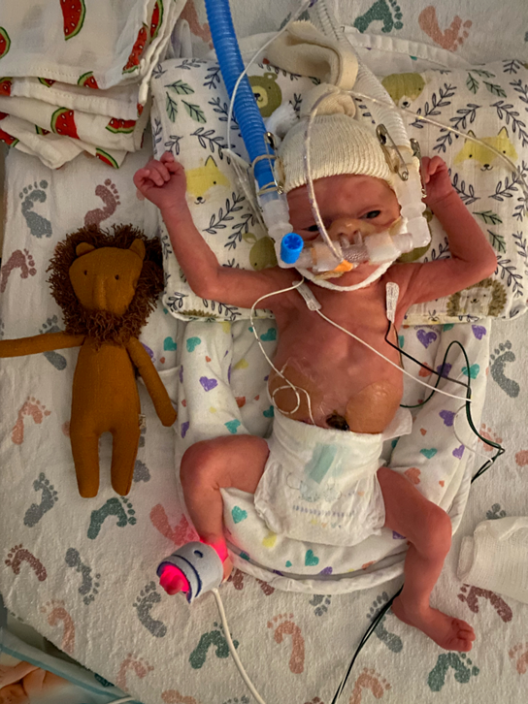


Dedication

Slide 3


Affiliations & Disclosures
Owner, Infant Feeding Care:
  Clinical Practice & Education
Owner, Infant Feeding Labs
  Research on Flow Rates of Bottle Nipples
Research affiliation: Mass General Brigham, Boston, MA

Slide 4
Outline
NICU experience, early feeding difficulties, and the relationship to later feeding.
What we know about feeding after NICU discharge.
  Risk factors that we can identify
Assessment of feeding in neonatal follow-through programs.
  Parent-reported Assessment Tools
Strategies to consider for management of feeding difficulties in follow-through programs.
Note: QR codes

Slide 5
Objectives
Describe 3 factors from NICU hospitalization that increases risk of feeding difficulties in early childhood.
Identify 2 parent-reported assessment tools that can be used to identify feeding difficulties after the NICU.
Explain 2 strategies that can be implemented in follow-through programs to support optimal feeding outcomes.

Slide 6

Feeding difficulties in infants with medical complexity
Feeding difficulties are extremely common in the NICU
  Prematurity
  Congenital heart disease
  Respiratory diseases
  Genetic disorders
  Congenital or acquired anomalies of the face, mouth, larynx, and GI tract
  Neurologic and neuromuscular disorders
Often the reason for extended hospitalization
Notes:
While the underlying disease processes or etiologies for feeding difficulties may be slightly different across these infants, they all experience similar difficulties in being able to safely and efficiently consume adequate amounts of nutrition by mouth for appropriate growth, development, and hydration.
Everyone wants this baby to be able to go home!

Slide 7

Feeding is one of the most complex activities of infancy
Multiple systems involved and contributing to success or difficulty
Neurologic
Face & Mouth
Larynx & Vocal Folds
Respiratory
Cardiac
Gastrointestinal
Notes:
The reason why feeding is such a challenge is because there are multiple systems involved that contribute to either success or difficulty with feeding. It is one of the most complex activities of infancy. It is not just a process involving the face and mouth, but a highly neurological process requiring careful timing of coordination of sucking, swallowing, and breathing. It requires functioning of the larynx and vocal folds to protect the airway. It requires the heart and lungs to provide adequate oxygenation to meet the needs of the body during this exercise. And it requires a functioning gastrointestinal tract. We have to think about all of these aspects of the individual baby when we think about why they may be struggling with feeding and make personalized decisions about how to help them. Feeding is a team sport!

Slide 8

The Infant born Prematurely
Neurologic
Face & Mouth
Larynx & Vocal Folds
Cardiac
Respiratory
Gastrointestinal
Notes:
In the premature baby who is learning to feed, there may be some neurological immaturity and/or acquired neurologic conditions (e.g., intraventricular hemorrhage) contributing to difficulties with coordinating sucking, swallowing, and breathing. Also remember that babies who have a primary diagnosis of prematurity can have other contributors (tongue-tie)

Slide 9

The Infant with Congenital Heart Disease
Neurologic
Face & Mouth
Larynx & Vocal Folds
Cardiac
Respiratory
Gastrointestinal
Notes:
For example, in the baby with CHD, their cardiac function

Slide 10

Trauma
While it is never our intention to harm, we have to acknowledge that there is trauma that is an unintended consequence of the interventions that are necessary (mostly) to save the infant’s life.
Awareness and acknowledgement of this trauma for the infant and the family is critical to approaching the care of these infants and families in a trauma-informed manner
Coughlin, 2021
Notes:
How do we balance these unintended but necessary experiences with positive experiences. What can we take away from the negative experience side? How can we approach our care to reduce pain and trauma whenever possible? When negative experiences need to happen, what can we do to support that baby through them? What can we do to promote positive experiences to outweigh the negatives?

Slide 11




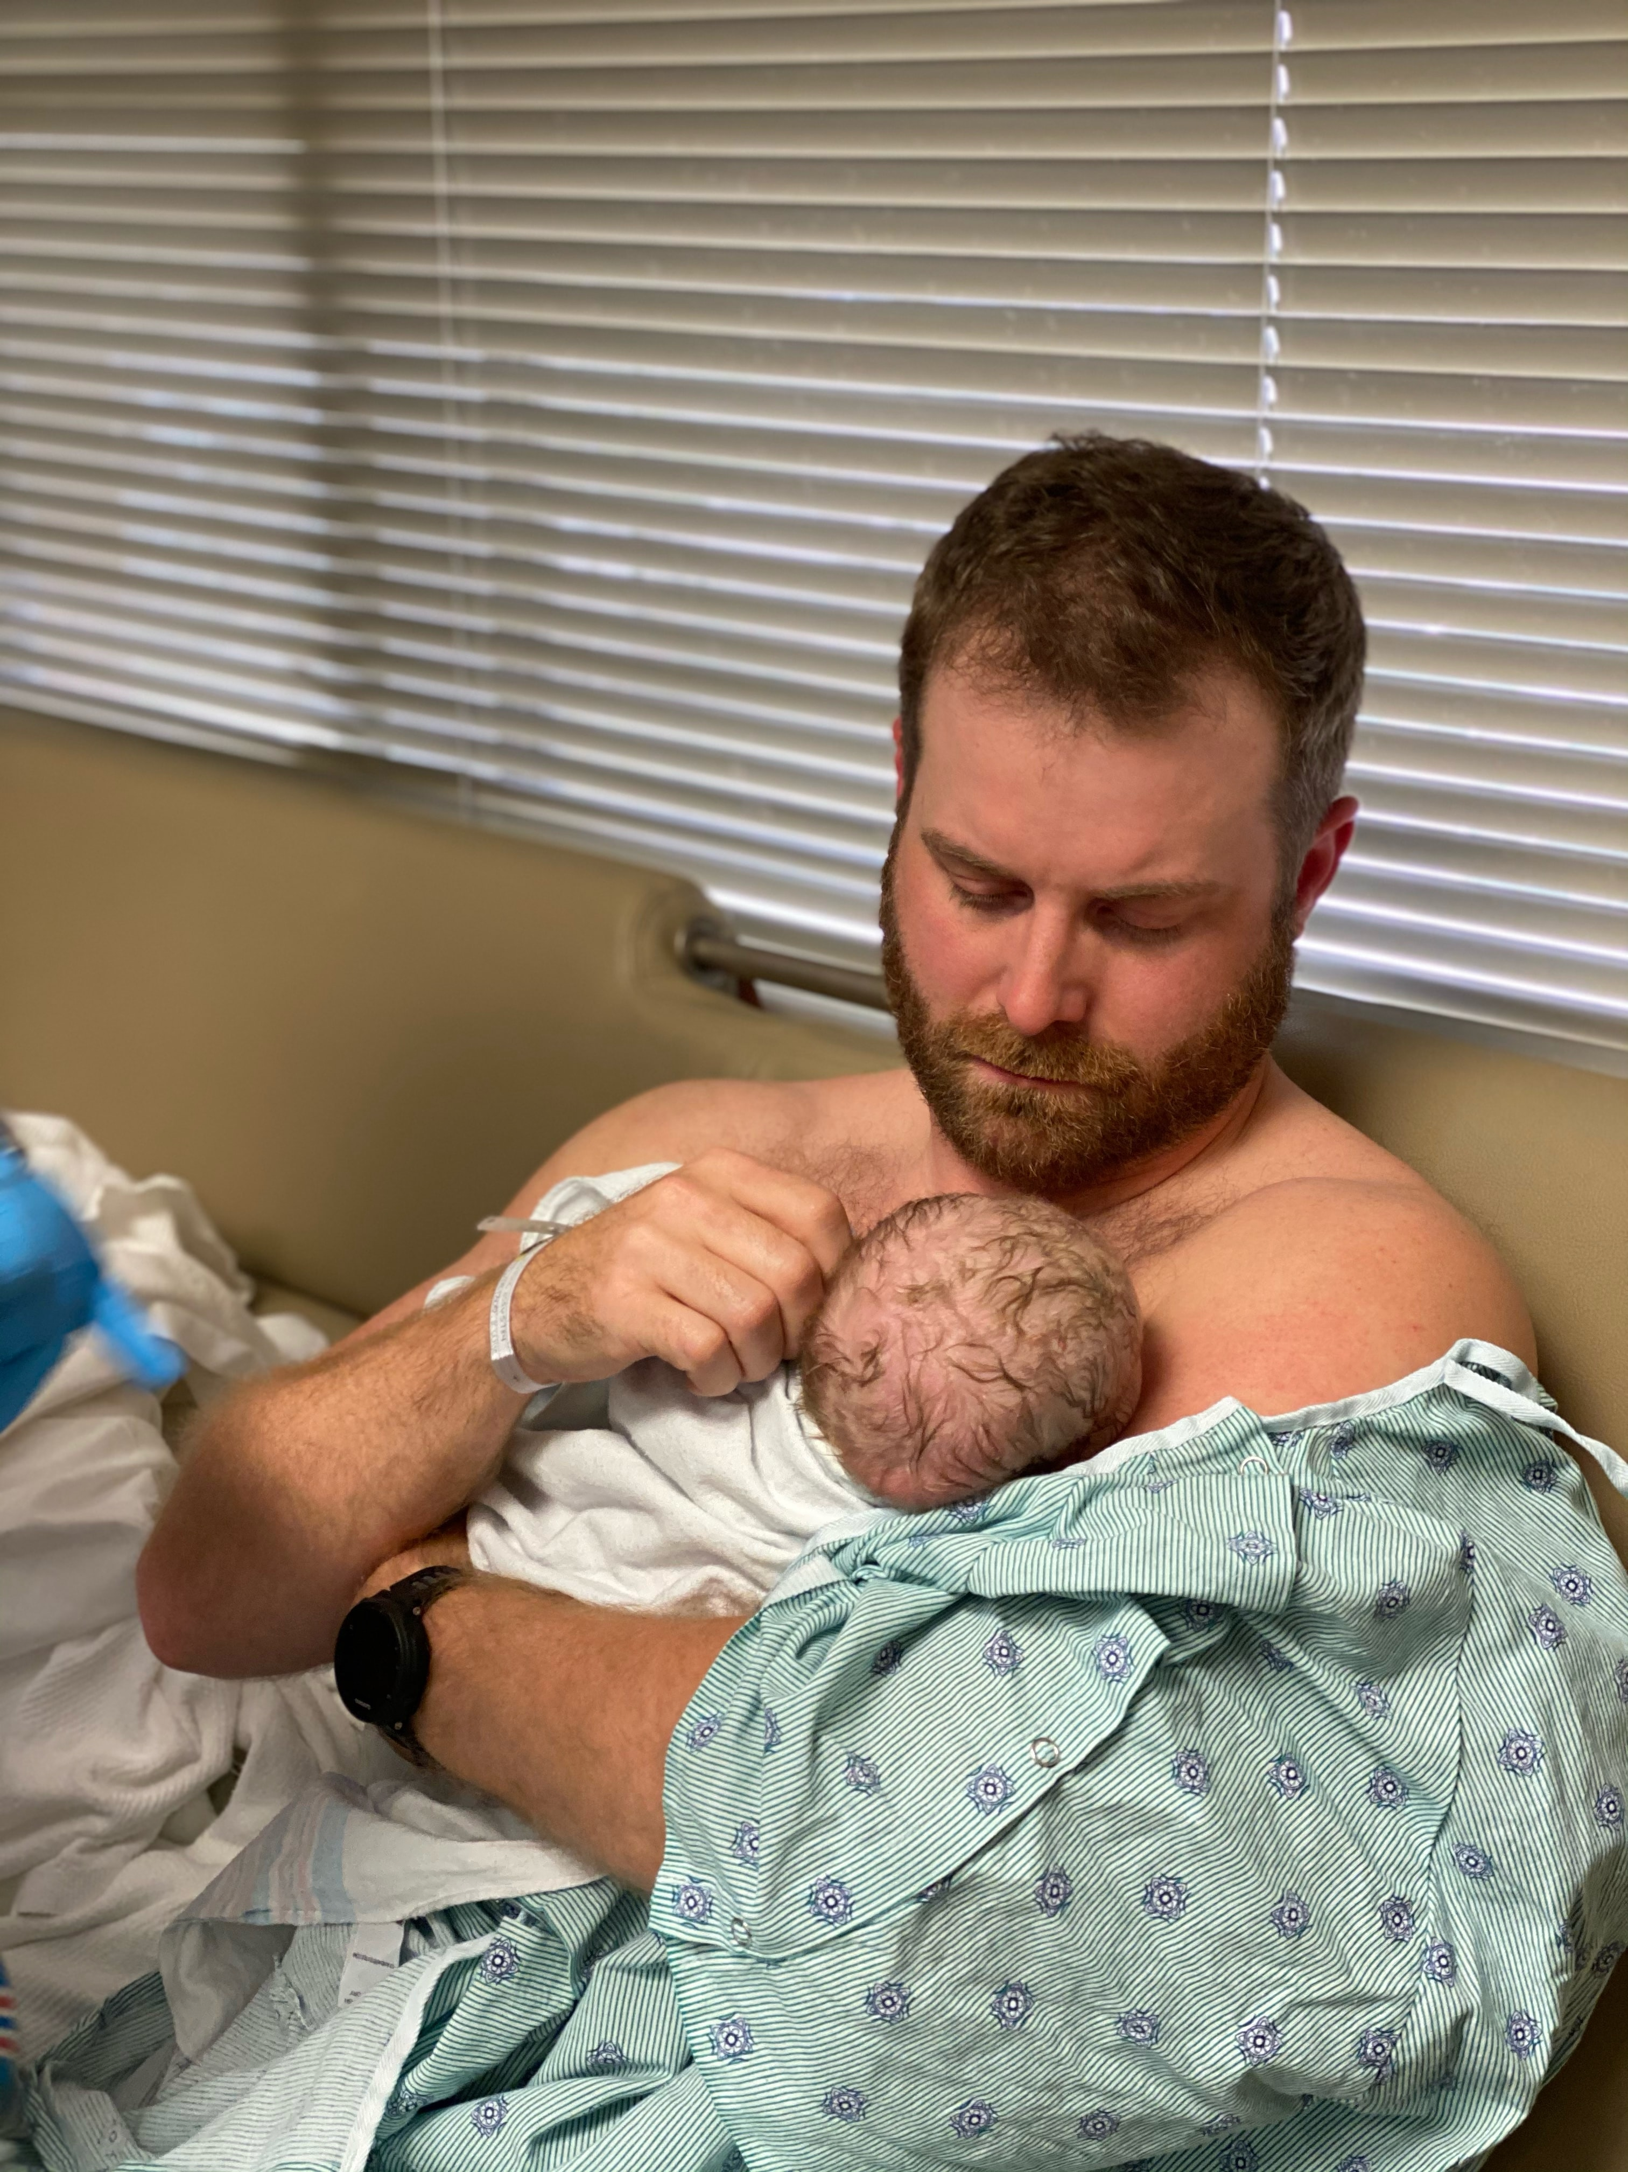


Experiences of babies & families outside of the ICU
Notes:
Comfort, safety; Closeness to parent; Skin, soft materials; Voices of family; Parents, siblings, grandparents are bonding; Smells of parents, breastmilk; Typical noises of life; Sleep; minimal pain and discomfort

Slide 12

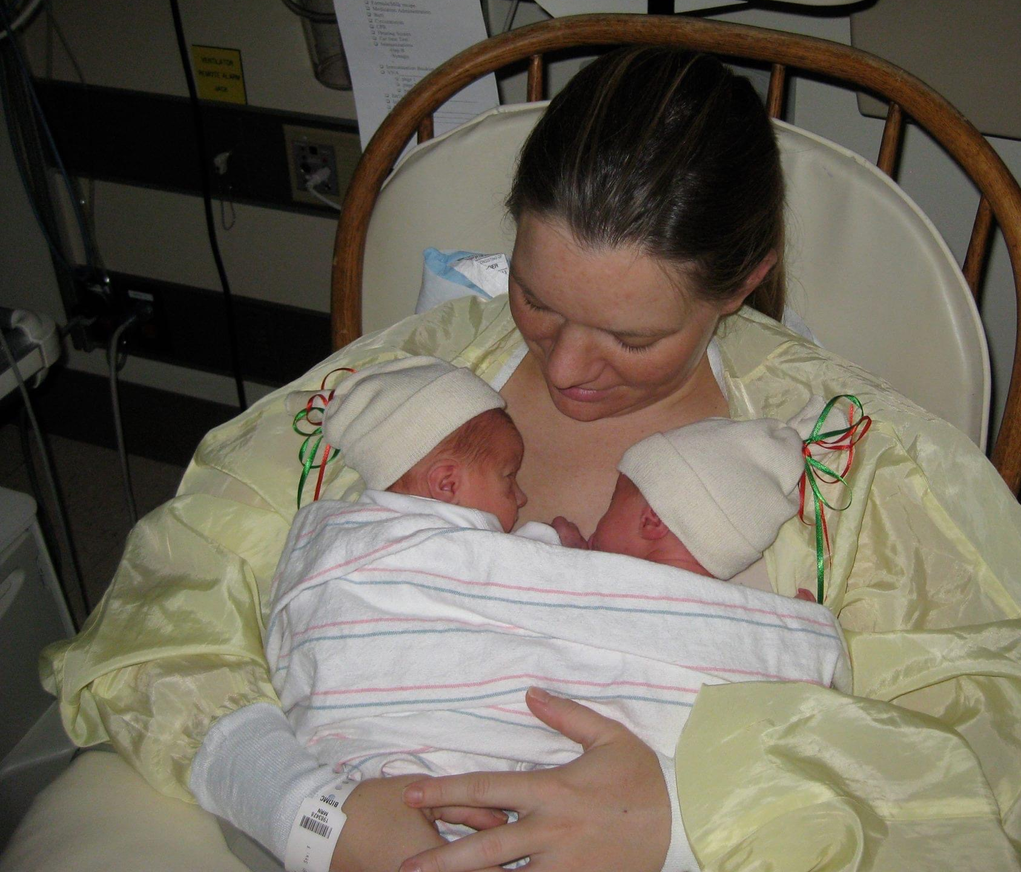
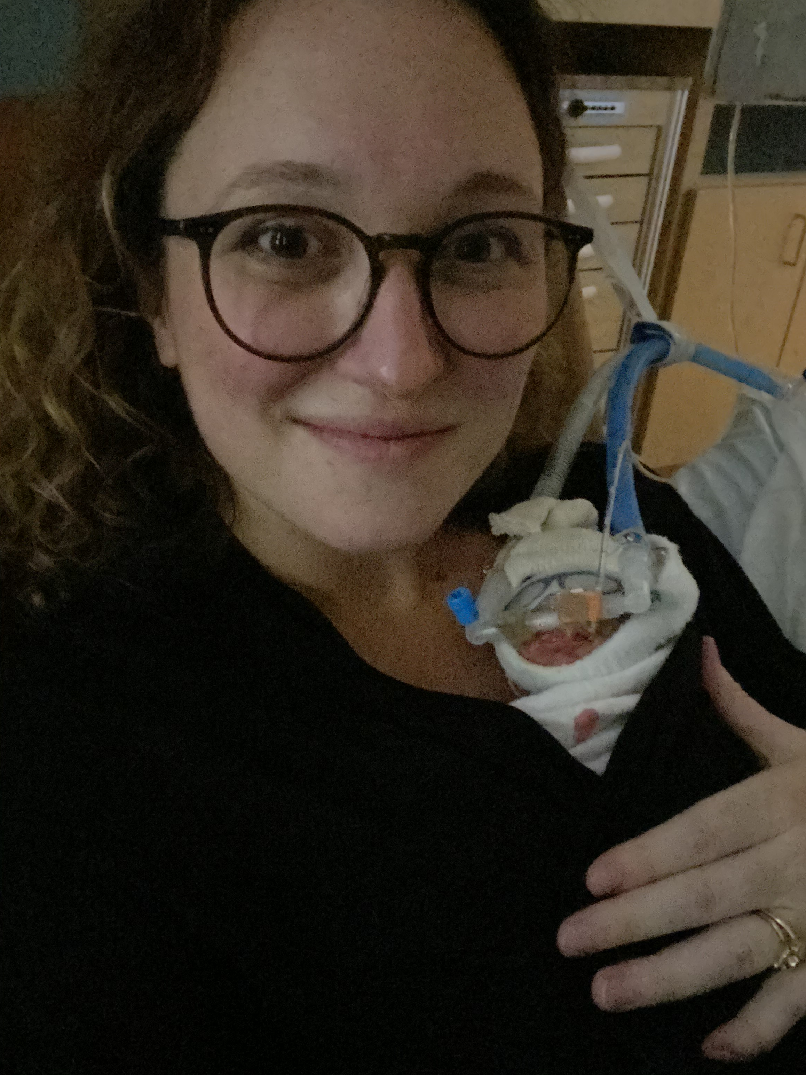
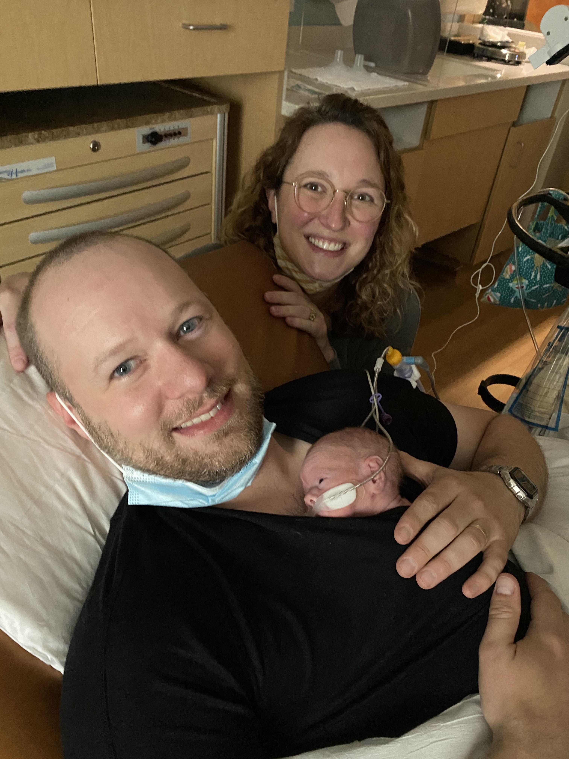

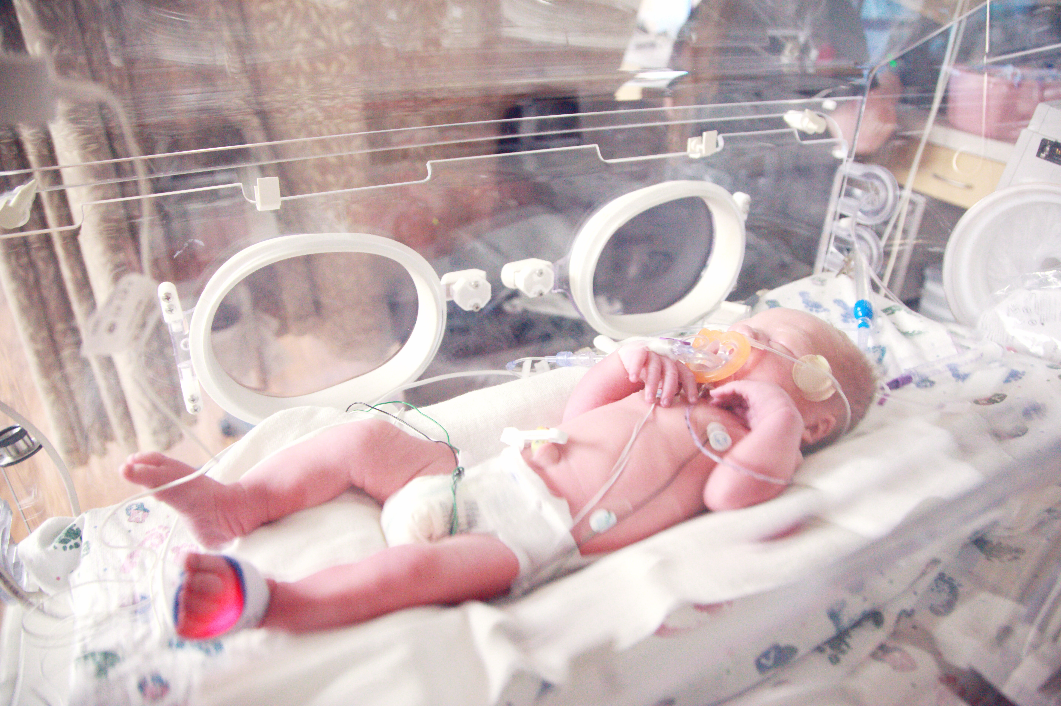
Experience of babies & families in the ICU
Notes:
Separation from parents (major source of stress for the mammal); Pain; Hard materials; Tape (face and mouth); Tubes; Alarms; Loud, unfamiliar noises; Interrupted sleep; Negatives experiences to the face and mouth (a highly innervated area of the body)
For families - Stress about health & well-being (short & long-term); Separation from baby; Unusual equipment; Loss of expected experience; Guilt; Worry about future; Financial stress; Isolation; Lack of understanding by family & friends; Stress of managing children/pets at home with baby in hospital; Sleep deprivation; Nutritional deprivation; Exacerbated by COVID-19
Preterm birth disproportionally impacts Black, Native American, and Hispanic families. Families with fewer financial resources, unable to take time off work, live further away from hospital, have unreliable transportation, have unreliable housing, etc are also disproportionally impacted

Slide 13
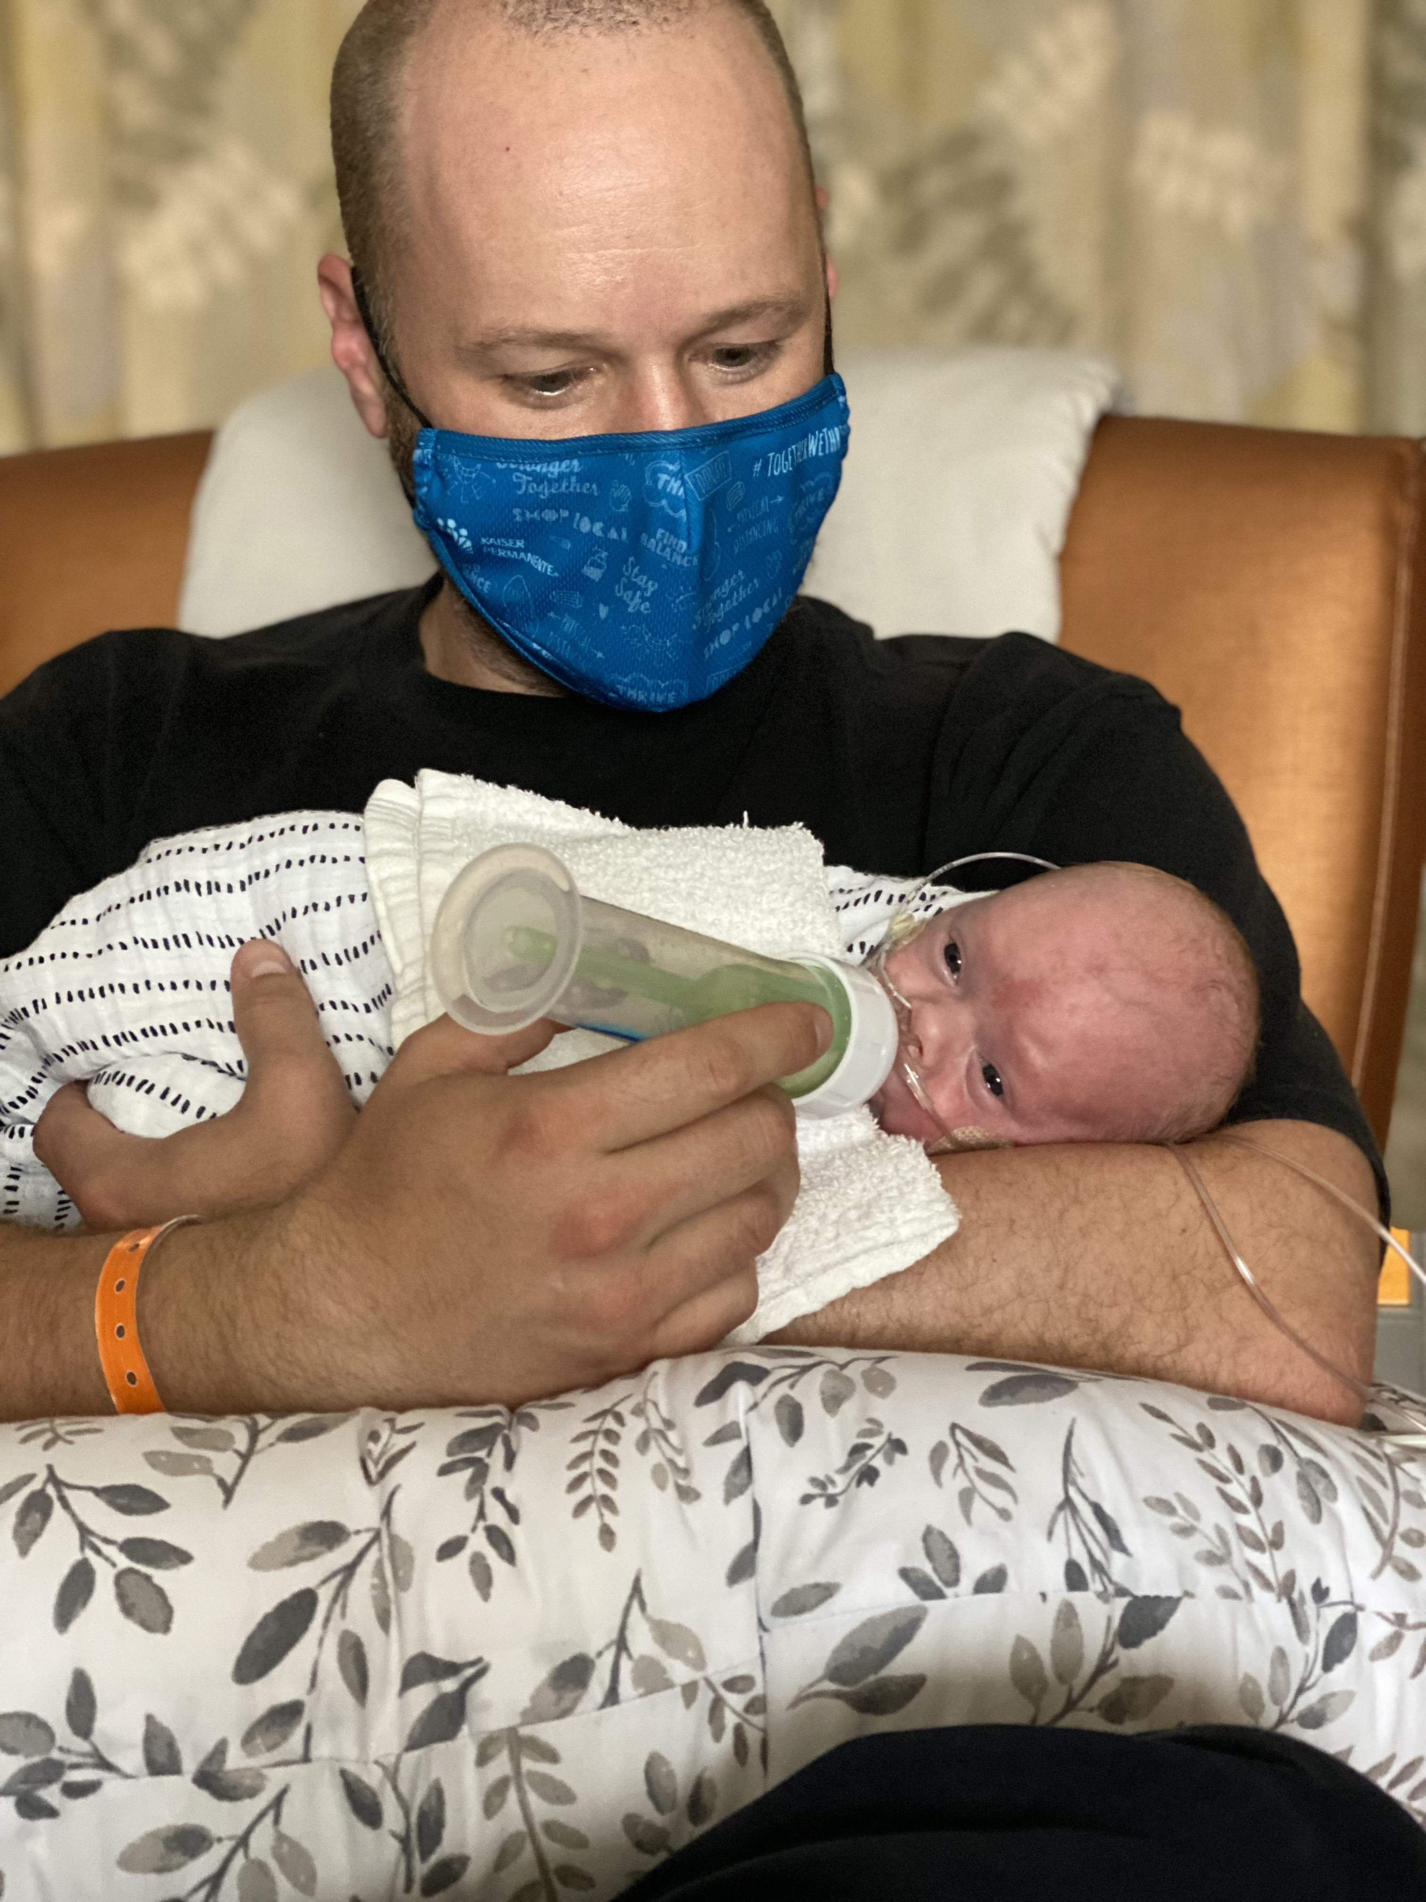
Feeding difficulties beyond the NICU
Recent focus on “cue-based” and “infant-driven” feeding practices
  Quality of feeding vs. quantity
The way we feed infants in the early days, weeks, and months has a long-term impact on that child and family

Slide 14


Prematurely-born Infants
In a meta-analysis of 4381 infants born premature (< 37 weeks gestation) –
42% experienced problematic feeding in the first 4 years of life (Pados, Hill, Yamasaki, Litt, & Lee, 2021)
  Likely an underestimate because most studies exclude the most medically-complex infants and assessment of feeding in these studies was inadequate

Slide 15
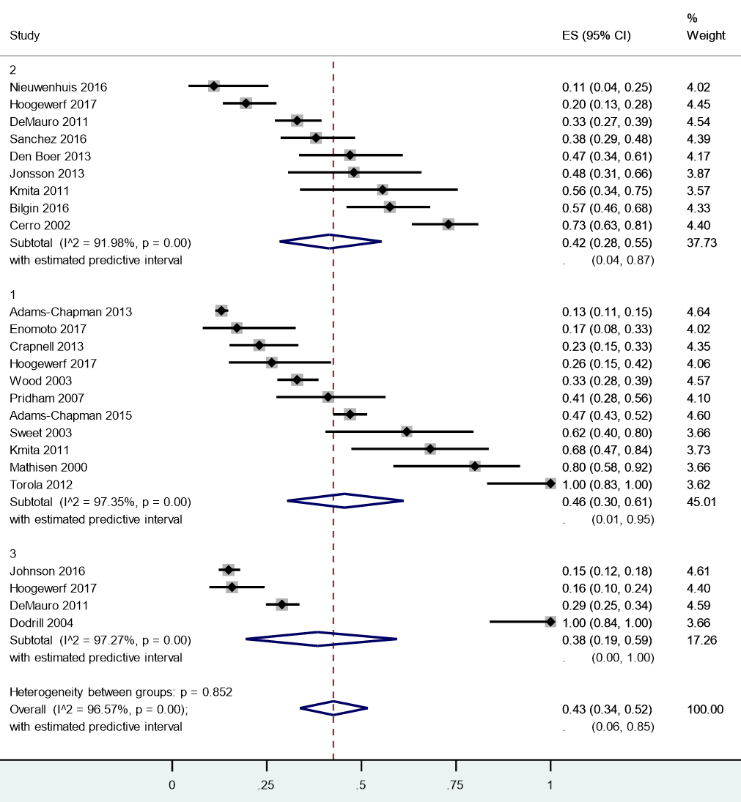
By Degree of Prematurity
Extremely Preterm (< 28 wks; n = 2503):
  46% (95% CI: 30 -61%)
Very Preterm ( 28 – 32 wks; n = 723):
  42% (95% CI: 28 – 55%)
Moderate/Late Preterm (32 – 37 wks; n = 1113):
  38% (95% CI: 19 – 50%)
No statistically significant difference by degree of prematurity (p = .85).
  Likely because of the heterogeneity across studies.
Pados, Hill, Yamasaki, Litt & Lee (2021)

Slide 16
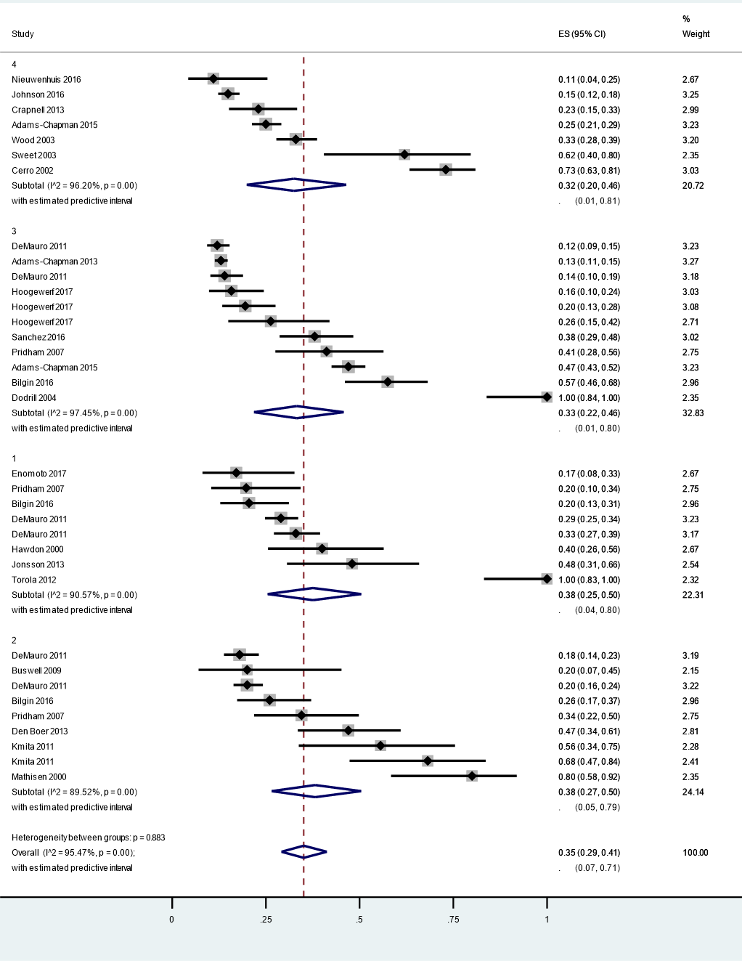
By Age at Time of Study
FT - 6 mos old (n = 851): 38% (95% CI: 25 – 50%)
6 – 11 mos (n = 895): 38% (95% CI: 29 – 41%)
12 – 23 mos (n = 3114): 33% (95% CI: 22 – 46%)
24 – 48 mos (n = 1577): 32% (95% CI: 20 – 46%)
Heterogeneity across studies within each age category
  Again, measured and defined differently
No statistically significant difference by age at time of study (p = . 88)
  Take away: Preterm infant feeding does not get better as they get older.
Pados, Hill, Yamasaki, Litt & Lee (2021)

Slide 17

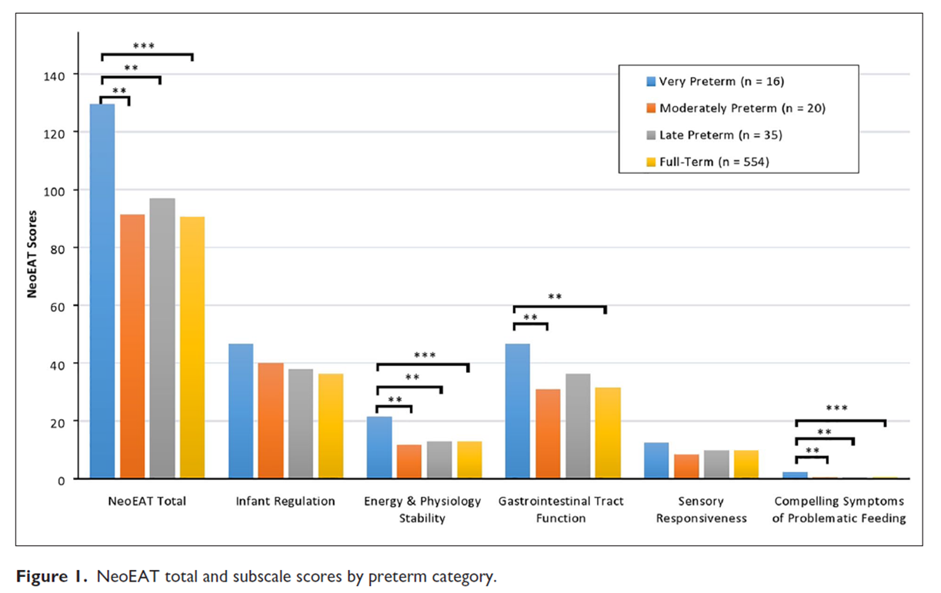
“Bottle-feeding challenges in preterm-born infants in the first 7 months”
Very preterm infants (< 32 weeks’) had significantly more symptoms of problematic feeding than infants born at later gestational age
  Across multiple domains of feeding
Factors associated with problematic feeding
  Bronchopulmonary dysplasia
  Gastroesophageal reflux
  Structural anomalies of the face, mouth, and GI tract
  History of breastfeeding difficulty
Hill, Park, & Pados (2020)

Slide 18
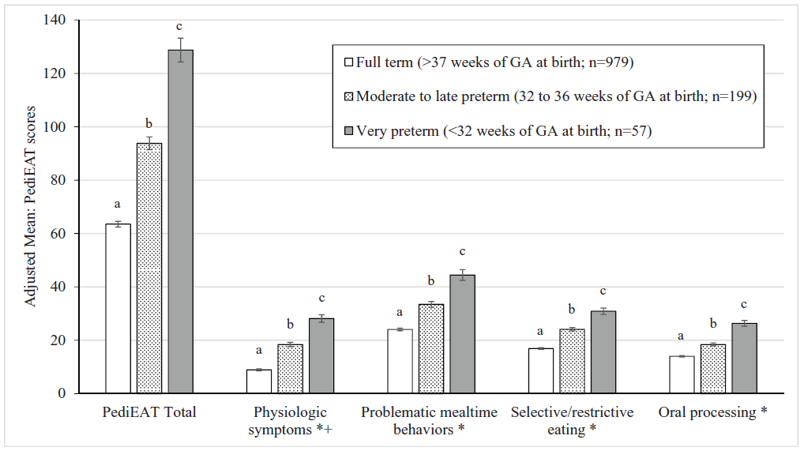
“Symptoms of problematic feeding in preterm-born infants at 6 months – 7 years”
Both very preterm infants (< 32 weeks’) and moderate to late preterm infants (32 – 36 6/7 weeks’) had more symptoms of problematic feeding than full-term infants
Within the preterm sample (n = 256); controlling for age, sex, & preterm group
  Feeding concerns during infancy
  Oxygen requirement > 40 weeks
  Congenital heart disease
  Structural anomaly of the face, mouth, or GI tract
  Genetic disorder
  Cerebral palsy
  Developmental & speech-language delay
  Vision impairment
  Sensory processing disorder
  Gastroesophageal reflux
Park, Thoyre, Pados, & Gregas (2019)

Slide 19

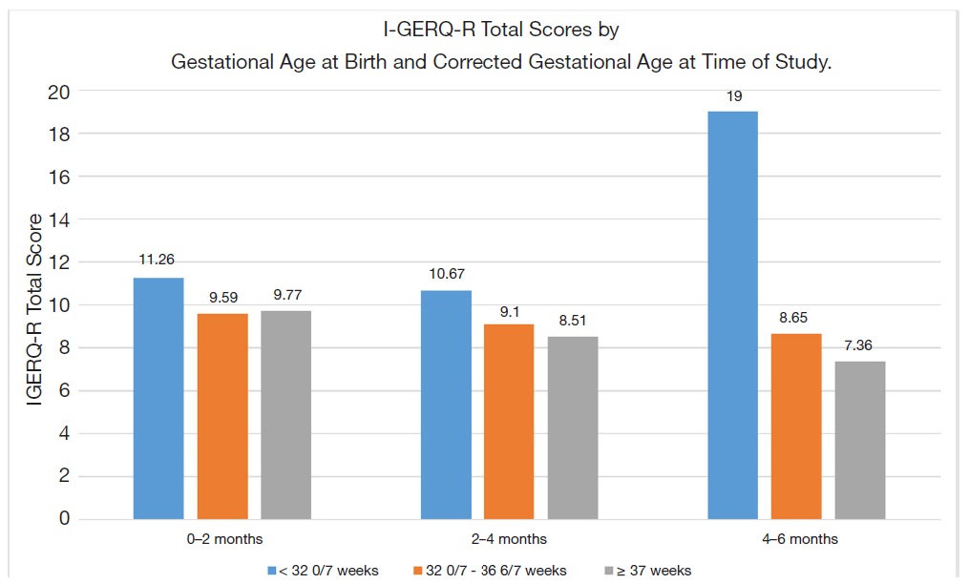
Preterm-born infants and GER symptoms
Symptoms of gastroesophageal reflux (GER) in preterm infants is controversial
Infants born full-term have decrease in GER symptoms over time
Infants born 32 – 37 weeks, no change
Infants born < 32 weeks, increase in symptoms
Preterm infants with symptoms of GERD have higher levels of intestinal inflammation (Shelly et al., 2021)
Pados, Briceno, Feaster, & Gregory (2021)

Slide 20

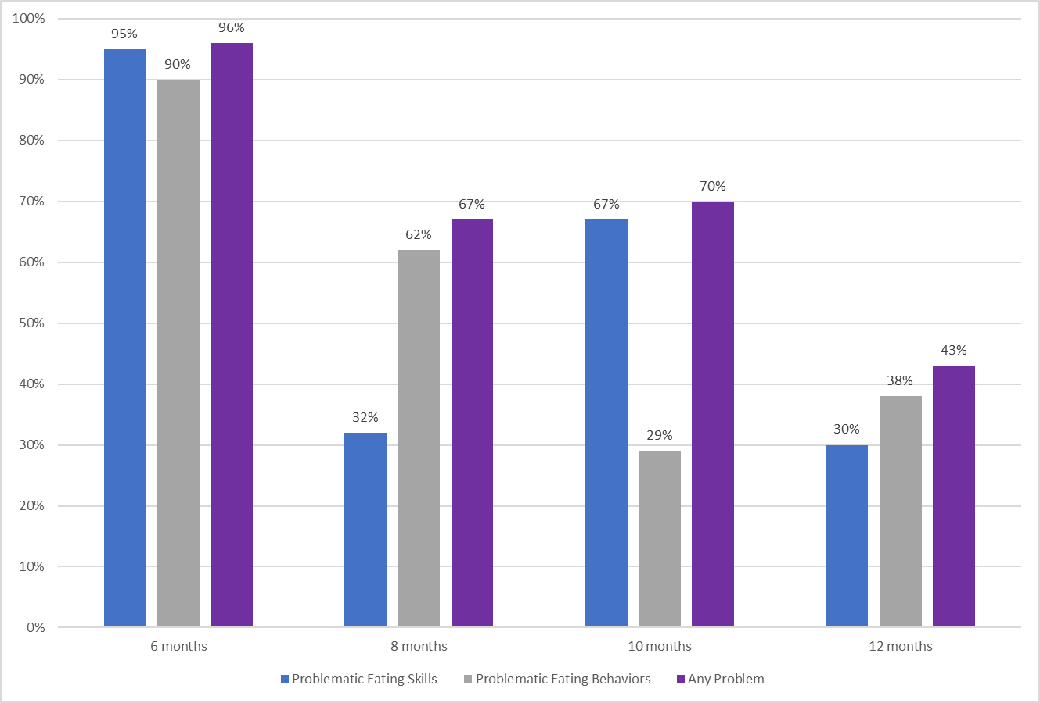
“Feeding at 6-12 months in infants with CHD”
In a study of 30 infants with congenital heart disease
“Problematic feeding” was common
  6 months: 96%
  8 months: 67%
  10 months: 70%
  12 months: 43%
Infants with more symptoms of GI distress and GER had more symptoms of problematic feeding.
Pados & Harrison (2022)

Slide 21
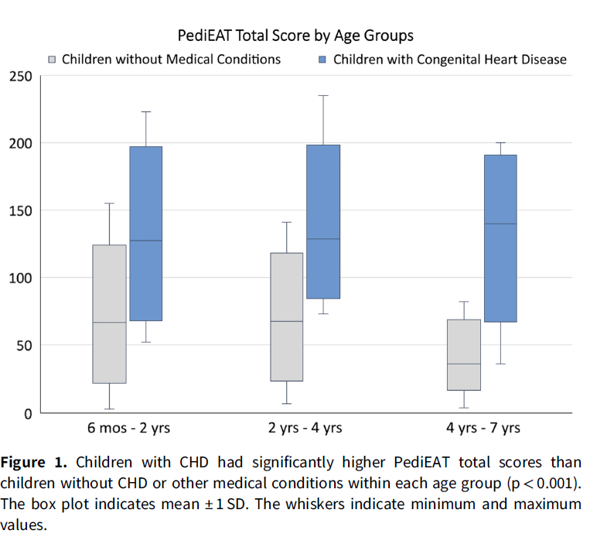
“Symptoms of problematic feeding in children with CHD compared to healthy peers”
Children with CHD had significantly more symptoms of problematic feeding than healthy peers at each age and across all domains of feeding
A history of difficulty with breastfeeding or bottle-feeding was associated with later symptoms
Pados (2018)

Slide 22
Risk Factors for Later Feeding Difficulties
Preterm birth (< 37 weeks); the more premature, the high risk; < 32 weeks highest risk
Bronchopulmonary dysplasia or requiring supplemental oxygen > 40 weeks
Any history of endotracheal intubation; the longer, the higher risk
Gastroesophageal reflux
Gastrointestinal distress
Structural anomalies of the face, mouth, and GI tract
Airway malformations (laryngomalacia, etc)
Neurological conditions
History of breastfeeding or bottle-feeding difficulty early in infancy
Congenital heart disease, especially if cyanotic heart disease
Cardiac surgery, especially involving the aortic arch (including PDA), or ECMO
Genetic disorder
Cerebral palsy
Developmental & speech-language delay
Vision impairment
Sensory processing disorder
Younger current age

Slide 23
Assessment of Feeding in Neonatal Follow-Through Programs
Valid and reliable parent-reported assessment tools for feeding
  Completed by a parent or caregiver that is familiar with the child’s feeding in the past two weeks
  Intentionally acknowledging the parent as the expert on their child’s feeding
    Over time and in different situations and environments
  Do not require any training (i.e., can be completed even if no feeding specialist is in the follow-through program)
  Free
  Available in multiple languages
  Available to parents outside of neonatal follow-through programs

Slide 24
Benefits of Parent-Reported Assessment Tools – for Professionals
In Follow-Through Programs, may help:
  Identify whether a child’s feeding falls within the typical range for their age (or whether they need specialized help with feeding); insurance coverage for referral
  Communicate with families about their specific concerns
  Provide reassurance to families when a child’s feeding does fall within typical
In Feeding Specialty Care, may help:
  Understand underlying factors contributing to feeding
    Implement targeted intervention
    Refer to appropriate specialists
  Evaluate response to interventions
  Provide objective data for insurance coverage of services

Slide 25

Benefits of Parent-Reported Assessment Tools – for Parents
Assessment Tools may help:
  Identify whether the child’s feeding falls within the range of typical for their age (or whether they need help with their feeding)
  Communicate concerns to your child’s healthcare providers and/or other family members
  Get a referral
  Get insurance coverage for specialty services
  See progress over time
    Sometimes slow progress is hard to see when you are in it every day

Slide 26

Feeding Assessment Tool for Infants
Birth – 7 mos
Neonatal Eating Assessment Tool (NeoEAT)
  Breastfeeding
  Bottle-feeding
  Mixed Breastfeeding and Bottle-feeding
Measures symptoms of problematic feeding in infants under 7 months
Higher scores indicate MORE symptoms of problematic feeding
Intended for infants who are primarily liquid feeding
See NeoEAT Reference Page

Slide 27
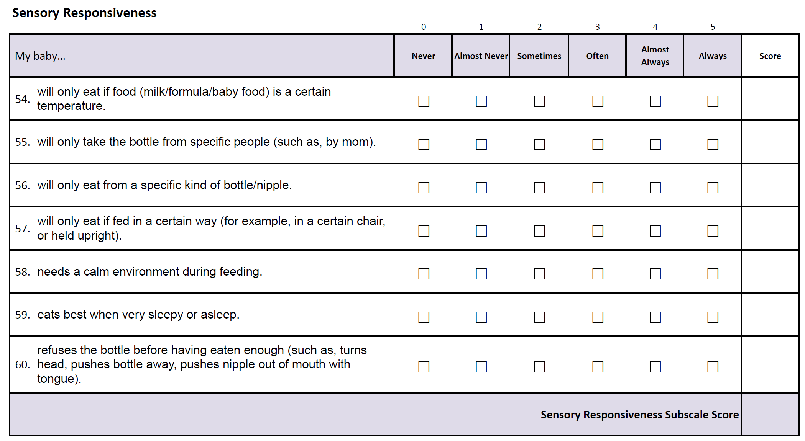

NeoEAT-Bottle-feeding Scoring - Example
2
5
5
4
5
4
3
28

Slide 28
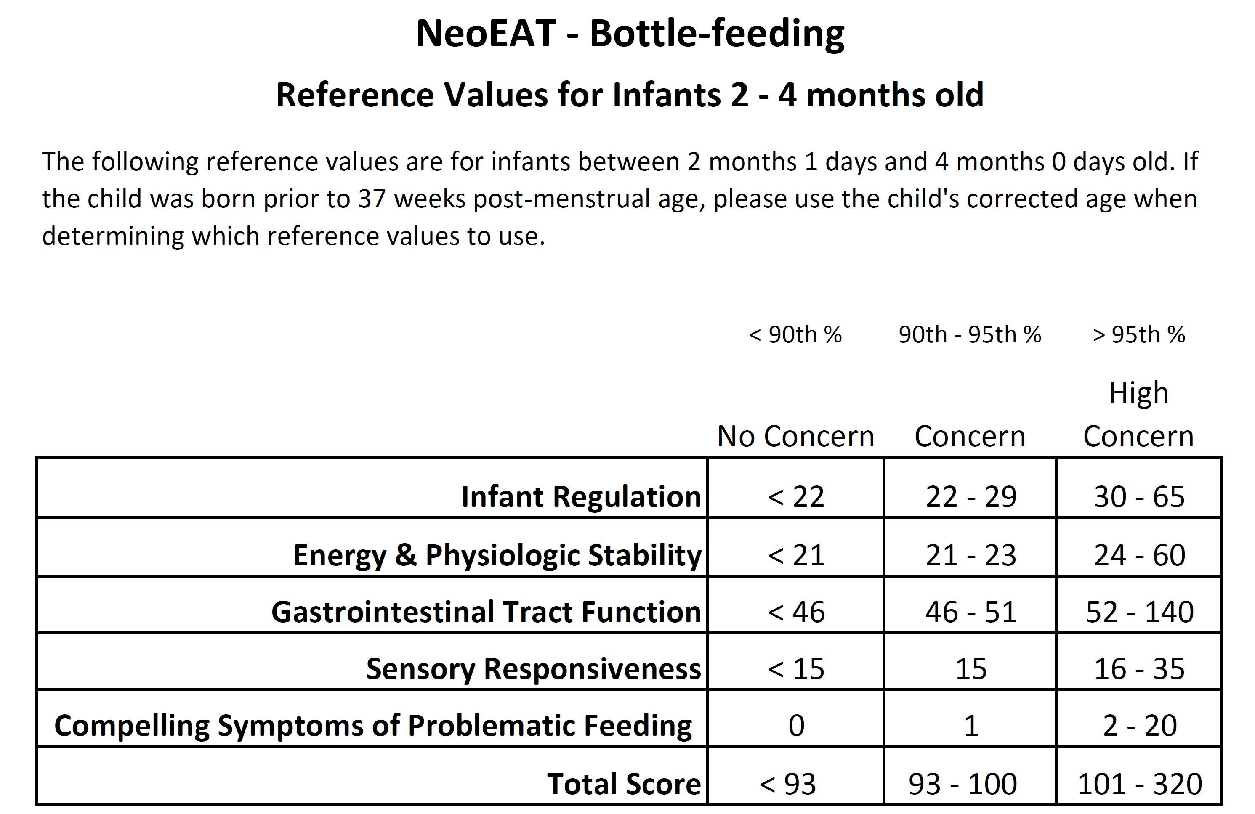
NeoEAT – Bottle-feeding Scoring Example

Slide 29
Reference Values
Reference values based on large samples of full-term, healthy infants whose parents indicated no concerns about feeding
  “Concern” 90th - 95th percentile
  “High Concern” > 95th percentile
  ANY subscale or total score > 90th percentile would be defined as problematic feeding.
IMPORTANT: NeoEAT Reference values were updated September 2022. If you have a previous version, discontinue use and download an updated version.
Limitations of reference values – based on a sample; use judgement
Also important to look at individual questions

Slide 30
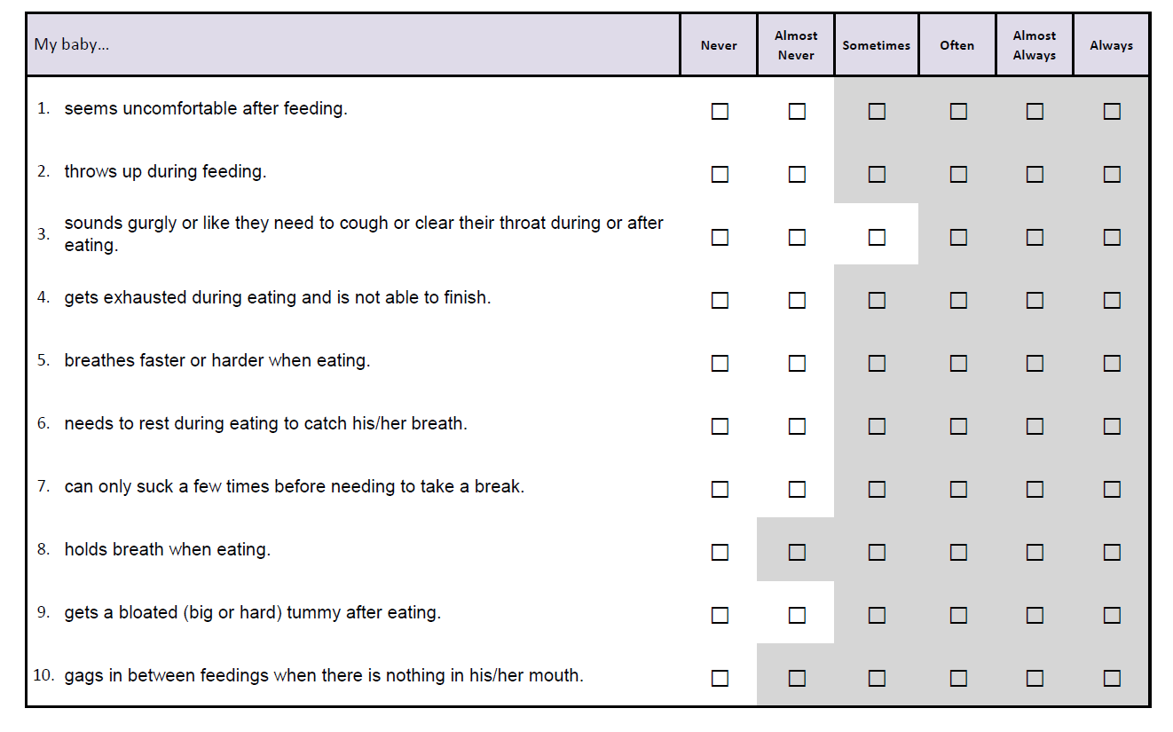
NeoEAT – Screening Instruments
Use for screening in situations where there are no current concerns
Example: Neonatal/Neurodevelopmental Follow-up Programs
Pass/Fail
ANY answer that falls in the “grey zone” warrants the parent completing the full, appropriate version of the NeoEAT

Slide 31

Feeding Assessment Tools for Infants & Children: 6 mos – 7 yrs
Pediatric Eating Assessment Tool (PediEAT)
  What a child is willing to eat (and their behaviors/preferences) in response to different foods
Child Oral and Motor Proficiency Scale (ChOMPS)
  What a child can eat (focus on eating and drinking skills along with gross and fine motor skills that support eating)
Both PediEAT & ChOMPS intended for infants and young children who are being offered some solid foods (non-liquids)
Available in multiple languages

Slide 32

Pediatric Eating Assessment Tool (PediEAT)
Full Version: 4 subscales
  Physiologic Symptoms
  Problematic Mealtime Behaviors
  Selective/Restrictive Eating
  Oral Processing
  Total Score
Screening Instrument – based on age (6 – 15 mos, 15 mos – 2.5 yrs, 2.5 – 7 yrs)
Higher scores indicate MORE symptoms of problematic feeding
See PediEAT Reference Page

Slide 33
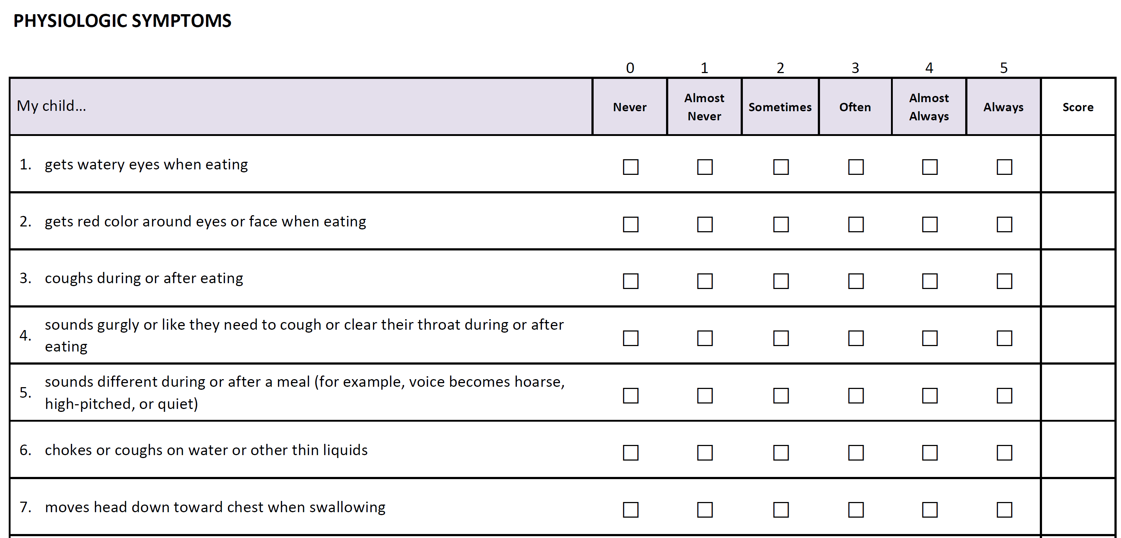
PediEAT Example

Slide 34
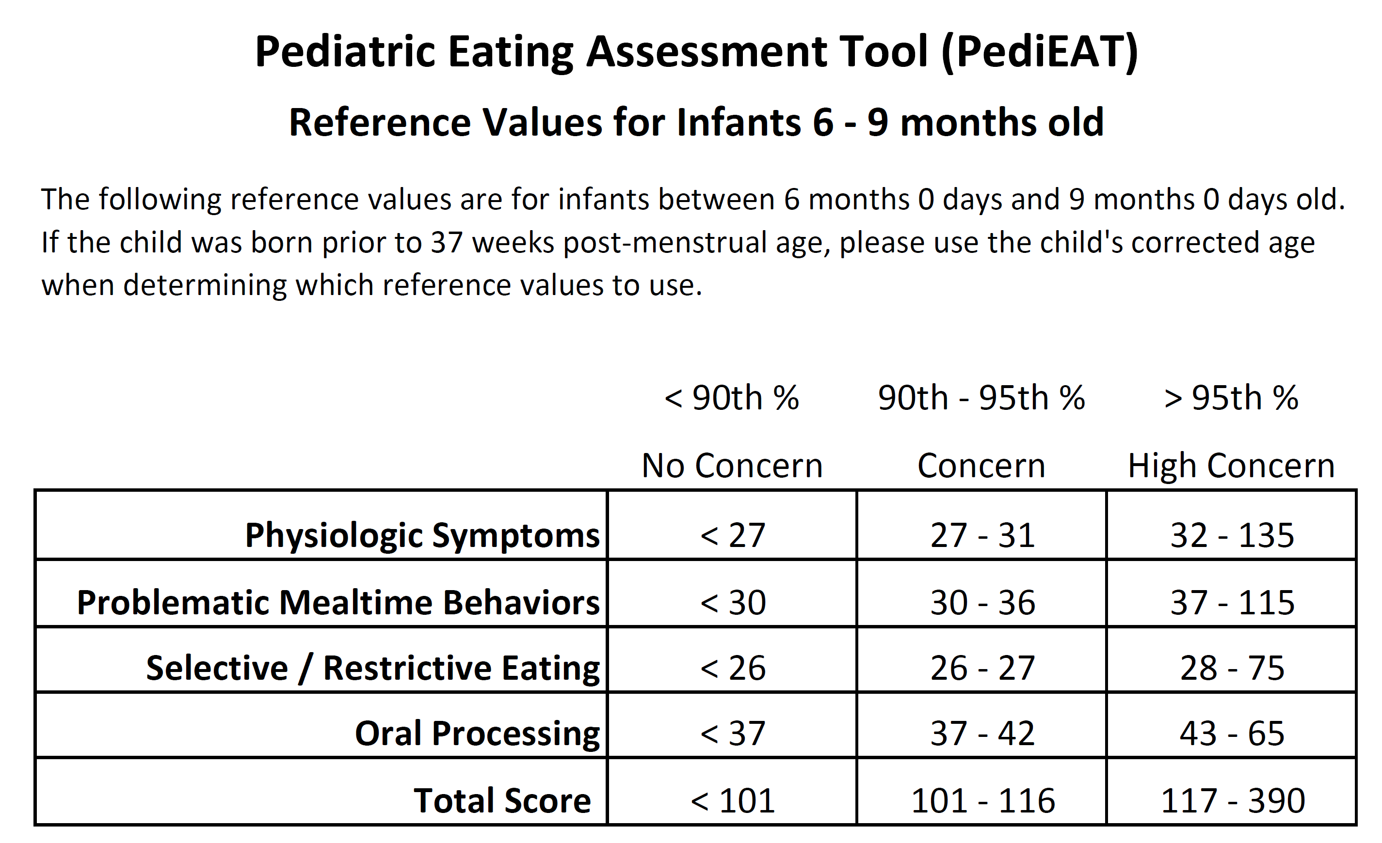

Example of PediEAT Reference Values

Slide 35
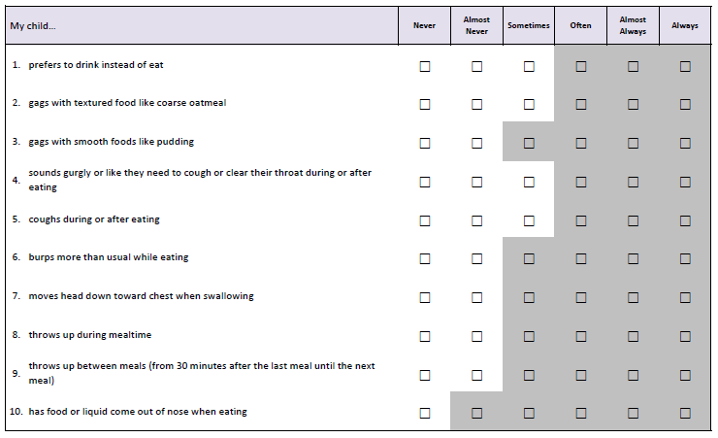
PediEAT Screening Instrument Example

Slide 36

Child Oral and Motor Proficiency Scale (ChOMPS)
Full Version: Four subscales
  Complex Movement Patterns
  Basic Movement Patterns
  Oral-Motor Coordination
  Fundamental Oral-Motor Skills
  Total Score
No screening version available yet
Lower scores mean lower skills/more problems (oppositive scoring to PediEAT)
See ChOMPS Reference Page

Slide 37
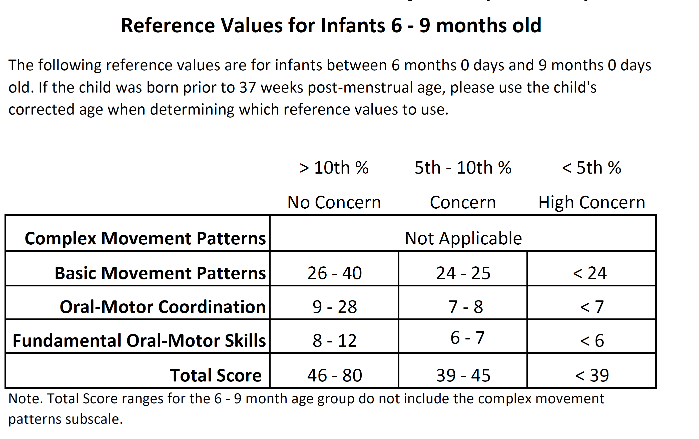

Example of ChOMPS Reference Values

Slide 38

Assessment of Feeding & the Family
Feeding Impact Scales
Family Management Measure of Feeding (FaMM Feed)
Can be used when child not taking solid foods/eating by mouth
Can be used with children birth to 18 years old
Useful for identifying whether the child’s feeding is impacting the psychosocial functioning of the family to meet that definition of Pediatric Feeding Disorder.

Slide 39
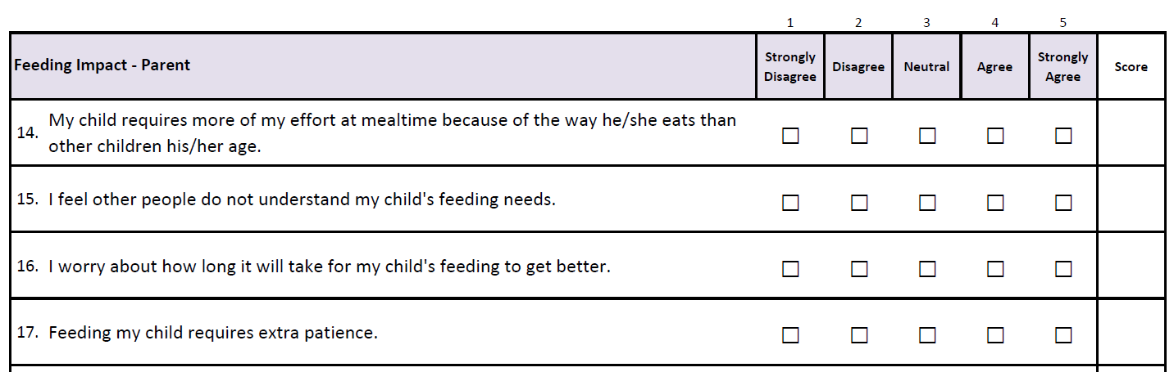
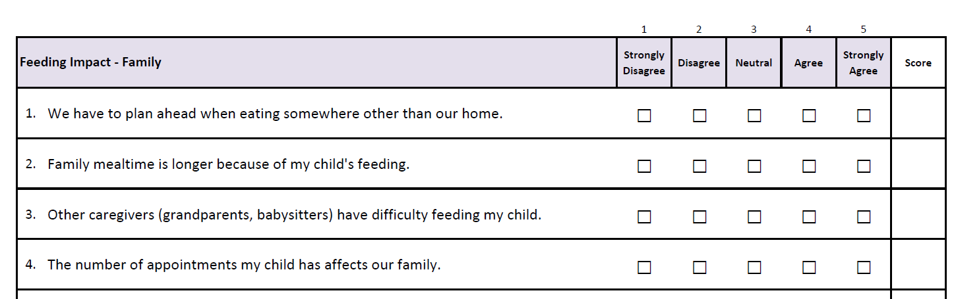
Feeding Impact Scales
Measures the impact of a child’s feeding on their parent and family
Two scales (no total score):
  Feeding Impact - Parent
  Feeding Impact – Family
Higher scores indicate more of an impact on the parent/family
No reference values yet
Estrem et al., 2020

Slide 40
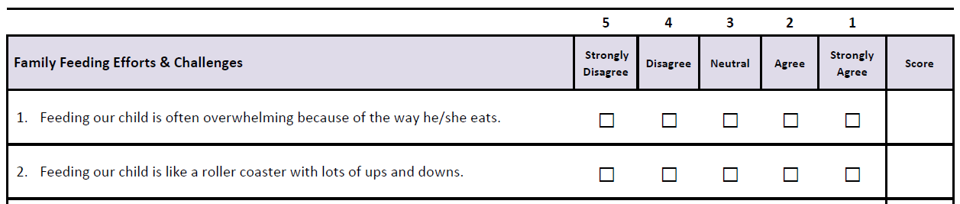
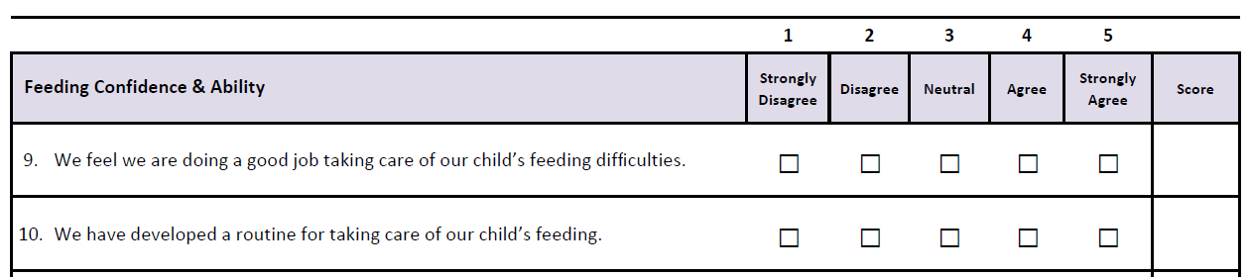
Family Management Measure of Feeding
Measures how families manage their child’s feeding disorder
Higher scores indicate better family management; no reference values
Six subscales (no total score)
  Family Feeding Efforts & Challenges
  Feeding Confidence & Ability
  Feeding Uncertainty & Concerns
  Future Feeding Outlook
  Feeding Related Family Life Difficulties
  Parent Mutuality on Feeding (if applicable)

Slide 41


Accessing the Assessments

Slide 42

After a feeding problem is identified…
Refer to appropriate specialists:
  Feeding Matters Provider Directory:
    https://www.feedingmatters.org/resources-support/provider-directory/
  Lactation: https://www.zipmilk.org/
  Early Intervention
Provide family with resources:
  https://www.feedingmatters.org/
Implement strategies while awaiting follow-up

Slide 43

Strategies for Infants
Support breastfeeding/human milk
Manage GI distress & Reflux symptoms (Pados & Davitt, 2020)
  Constipation
  Evaluate for symptoms of food allergy – consider maternal diet or formula change
  Probiotics (Indrio et al., 2010, 2014,
  Thickening (Enfamil AR or Gelmix) (Pados & Feaster, 2020)
Baby-wearing
Wake windows
Feeding needs to be as positive as possible

Slide 44

Strategies for Infants
Bottle-feeding –
  Single most important thing - Identify an appropriate bottle and nipple
  Swaddling
  Positioning

Slide 45
Help parents to identify an appropriate bottle & nipple for their baby
Flow rate is the rate at which milk moves through the nipple/teat into the infant’s mouth
With each swallow, the infant must hold their breath for ~ 1 second
  If RR > 60 breaths/min …
Higher flow rate → more respiratory interruption (Al-Sayed et al., 1994; Mathew 1991)
  If tachypneic or desaturated at baseline, unable to manage this interruption
Lower flow rate → swallow delayed
  More breathing
  More time to coordinate suck, swallow, breath
Unfortunately, we cannot rely on product labels to know the flow rate.

Slide 46
Note: Enfamil Extra Slow & Dr. Brown’s Newborn were not included in the publication
*OLD DATA*
Pados, B.F., Park, J., & Dodrill, P. (2019). Know the flow: Milk flow rates from bottle nipples used in the hospital and after discharge. Advances in Neonatal Care, 19(1), 32-41. doi: 10.1097/ANC.0000000000000538

Slide 47
Note: Enfamil Extra Slow & Dr. Brown’s Newborn were not included in the publication, but were tested later.
*OLD DATA*
Pados, B.F., Park, J., & Dodrill, P. (2019). Know the flow: Milk flow rates from bottle nipples used in the hospital and after discharge. Advances in Neonatal Care, 19(1), 32-41. doi: 10.1097/ANC.0000000000000538
Notes:
One thing to note here is that in the U.S., many hospitals use disposable or single-use products from the formula companies to feed babies. What these data show is that these products can be quite a bit faster than the products available for parents to purchase in the community.

Slide 48
Note: Enfamil Extra Slow & Dr. Brown’s Newborn were not included in the publication, but were tested later.
*OLD DATA*
Pados, B.F., Park, J., & Dodrill, P. (2019). Know the flow: Milk flow rates from bottle nipples used in the hospital and after discharge. Advances in Neonatal Care, 19(1), 32-41. doi: 10.1097/ANC.0000000000000538

Slide 49
Note: Enfamil Extra Slow & Dr. Brown’s Newborn were not included in the publication, but were tested later.
*OLD DATA*
Pados, B.F., Park, J., & Dodrill, P. (2019). Know the flow: Milk flow rates from bottle nipples used in the hospital and after discharge. Advances in Neonatal Care, 19(1), 32-41. doi: 10.1097/ANC.0000000000000538

Slide 50


Data-driven decisions about flow rates
Labels on packaging mean very little
Need to consider both flow and variability
For infants with history of medical complexity, a flow rate of < 10 mL/min with low to moderate variability is best in the first several months of life.
Type of formula may impact flow as well (Pados & Feaster, 2020)
When thickening needed, decisions about nipple selection also need to be data-driven
  Data available for this as well (Pados & Mellon, 2020)
Start slow. No data to suggest a baby has to be on a particular flow when they are discharged; they need to be safe
Notes:
Easy intervention

Slide 51

Swaddling
Supports flexed positioning
  Shoulders, hips
  Hands to midline
Helps infant to remain calm
Containment - Helps infant to reduce energy spent on managing limbs
Notes:
Safe; Physiologic stability, behavioral organization, airway protection; energy efficiency

Slide 52
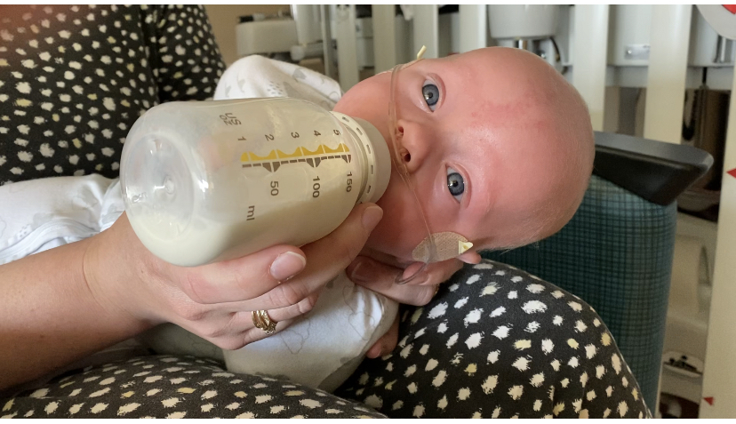
Positioning
Neutral alignment/slight flexion of neck
  Extension opens the airway and increases the risk of aspiration
Head midline
  Not turned to side
Side-lying positioning
  Ear, shoulder, hip

Slide 53
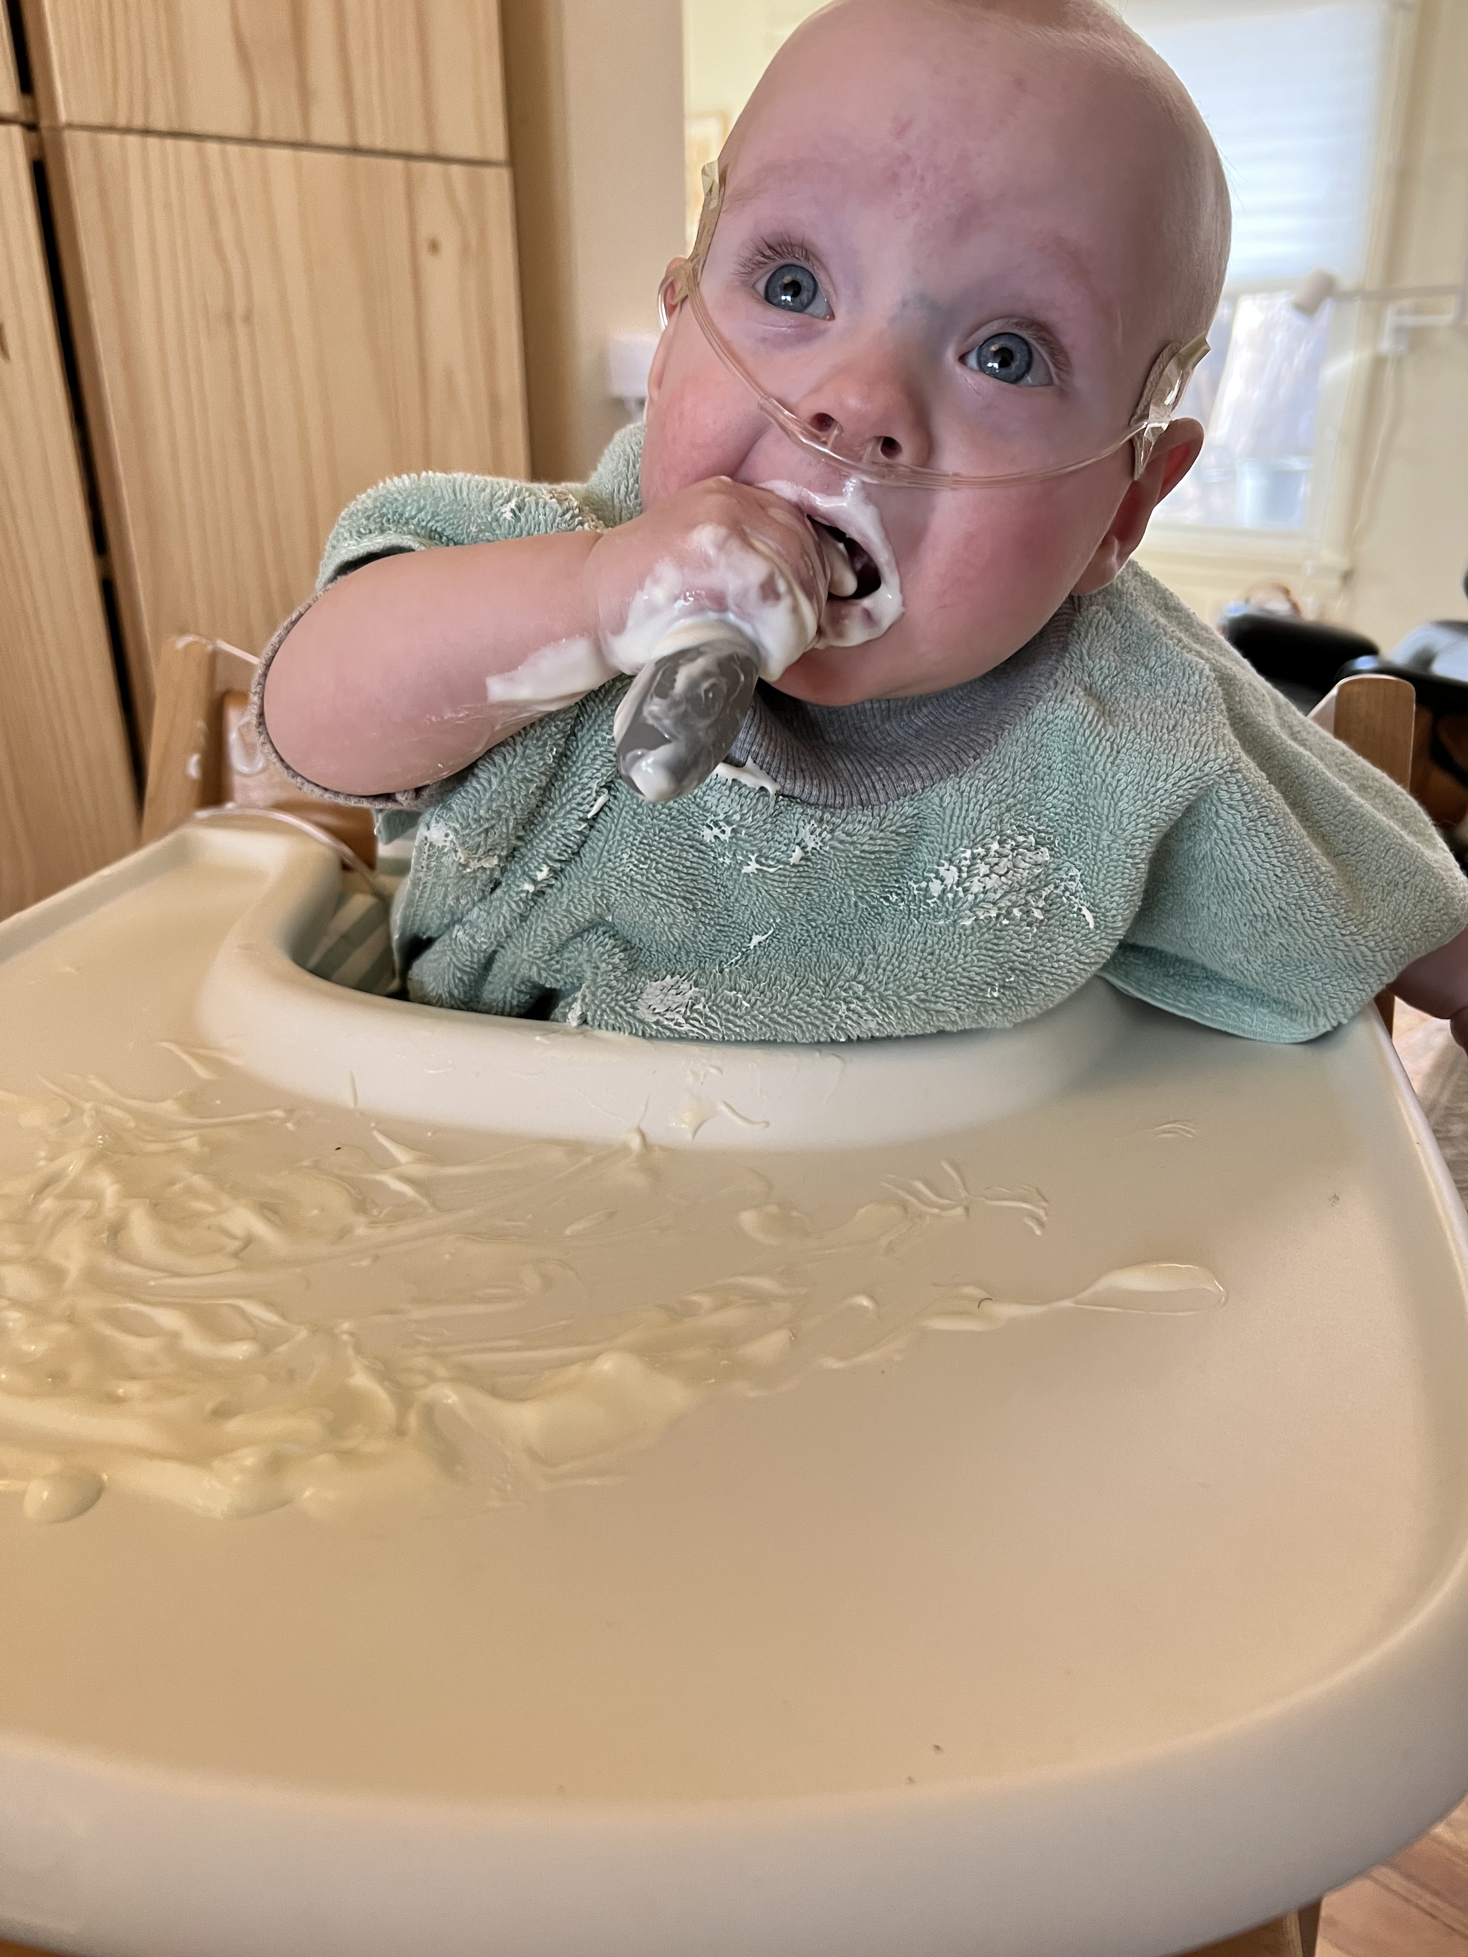
Strategies for children
Manage GI distress & Reflux symptoms (Pados & Davitt, 2020)
  Constipation
  Evaluate for symptoms of food allergy – provide guidance around introduction to solid foods
  Probiotics (Indrio et al., 2010, 2014)
Introduction of solid foods (evaluate readiness)
  Positive experience
  Supported positioning
  Exposure to tastes and textures
  Child learning to tolerate food on their face and hands
  Let toddlers be toddlers

Slide 54
Resources
Solid Starts: https://solidstarts.com/
  Guides & Videos on starting solids
  Database on how to cut & serve foods for different ages
Books:
  Responsive Feeding by Melanie Potock
  Your Baby’s Bottle-feeding Aversion by Rowena Bennett
Instagram Accounts:
  @solidstarts
  @jillrabinablw
  @mymunchbug_melaniepotock

Slide 55

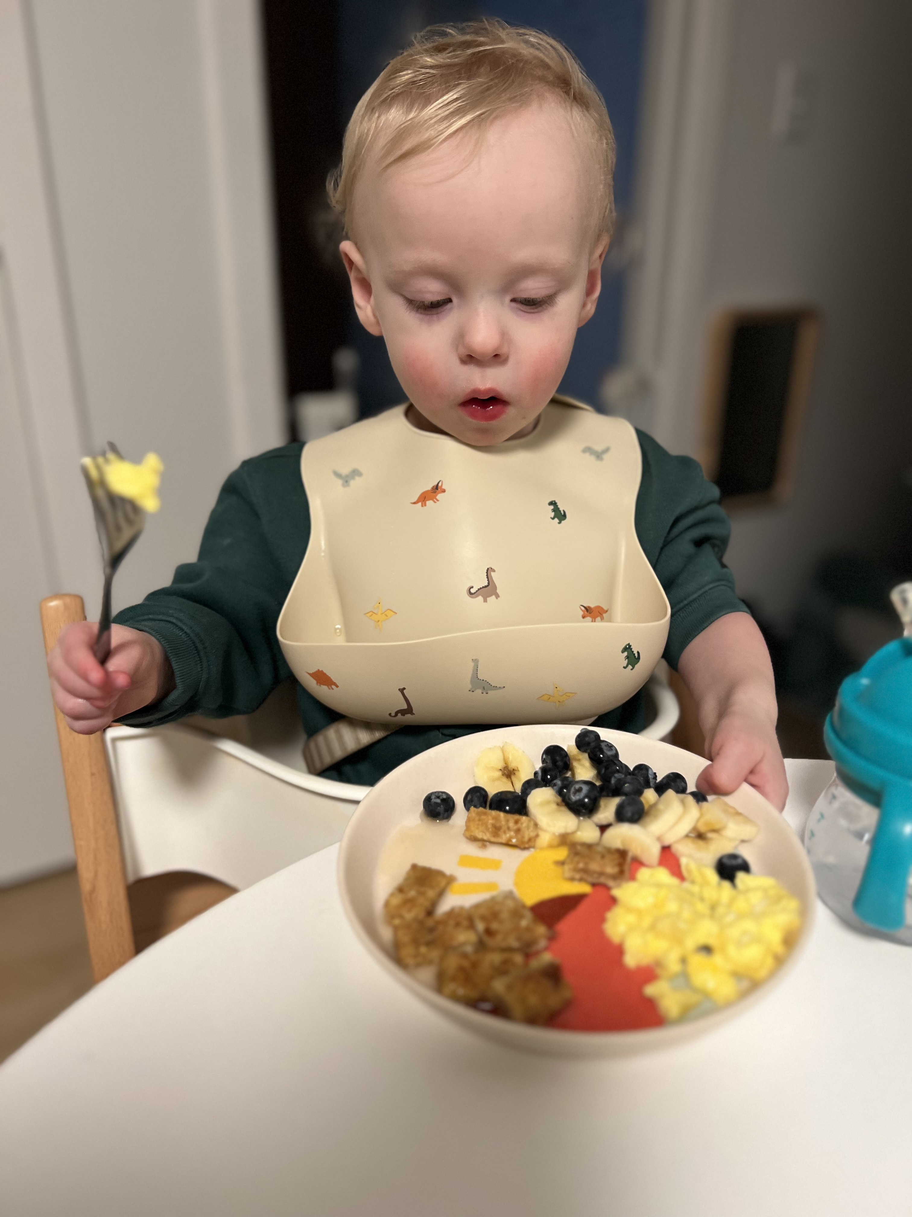
Infants who experience difficulties early on or who have certain risk factors are more likely to experience difficulties later in infancy and childhood
They don’t necessarily “grow out of it” and weight gain is not the only indicator of how feeding is going
Neonatal Follow-Through programs play an important role in identifying children in need of specialized feeding support
We can use parent-reported assessment tools to help identify feeding problems.
We can implement strategies in Neonatal Follow-Through programs to optimize feeding while we await follow-up with feeding specialists

Slide 56

Questions ?
Email: britt@infantfeedingcare.com
Instagram: @infantfeedingcare
Infant Feeding Care website: https://www.infantfeedingcare.com/
Assessment Tools
Courses
Infant Feeding Labs website: https://infantfeedinglabs.com/
Information on flow rates from bottle nipples
References

Slide 57
References and Sources
al-Sayed, L. E., Schrank, W. I., & Thach, B. T. (1994). Ventilatory sparing strategies and swallowing pattern during bottle feeding in human infants. Journal of Applied Physiology, 77(1), 78-83.
Coughlin, M.E. (2021). Transformative nursing in the NICU: Trauma-informed age-appropriate care, 2nd edition. Springer Publishing.
Ferrara, L., Bidiwala, A., Sher, I., Pirzada, M., Barlev, D., Islam, S., Rosenfeld, W., Crowley, C.C., & Hanna, N. (2017). Effect of nasal continuous positive airway pressure on the pharyngeal swallow in neonates. Journal of Perinatology, 37, 398-403.
Gosa, M. M., & Dodrill, P. (2017). Effect of time and temperature on thickened infant formula. Nutrition in Clinical Practice, 32(2), 238-244. https://doi.org/10.1177/0884533616662991
Hill, R., Park, J., & Pados, B.F. (2020). Problematic bottle-feeding in preterm-born infants in the first 7 months of life. Global Pediatric Health, 7, 1-14. doi: 10.1177/2333794X20952688
Mathew, O. P. (1991). Breathing patterns of preterm infants during bottle feeding: Role of milk flow. Journal of Pediatrics, 119(6), 960-965. doi: 10.1016/S0022-3476(05)83056-2
Marshall, J., Clarke, S., Escott, C., & Pados, B.F. (2020). Assessing the flow rate of different bottles and teats for neonates with feeding difficulties: An Australian context. Journal of Neonatal Nursing, 27(4), 285-290. doi: 10.1016/j.jnn.2020.11.014

Slide 58
References and Sources
Pados, B.F., Hill, R.R., Yamasaki, J.T., Litt, J.S., & Lee, C.S. (2021). Prevalence of problematic feeding in young children born prematurely: A meta-analysis. BMC Pediatrics, 21, 110. doi: 10.1186/s12887-021-02574-7
Pados, B.F., Park, J., & Dodrill, P. (2019). Know the flow: Milk flow rates from bottle nipples used in the hospital and after discharge. Advances in Neonatal Care, 19(1), 32-41. doi: 10.1097/ANC.0000000000000538
Pados, B.F. & Fuller, K. (2020). Establishing a foundation for optimal feeding outcomes in the Neonatal Intensive Care Unit. Nursing for Women’s Health, 24(3), 202-209. doi: 10.1016/j.nwh.2020.03.007
Pados, B.F. & Mellon, M. (2021). Effect of thickening on flow rates through bottle nipples. Journal of Obstetric, Gynecologic, and Neonatal Nursing, 50(1), 78-87. doi: 10.1016/j.jogn.2020.09.153
Pados, B.F. & Feaster, V. (2021). Effect of formula type and preparation on International Dysphagia Diet Standardisation Initiative thickness level and milk flow rates from bottle teats. The American Journal of Speech-Language Pathology, 30(1), 260-265. doi: 10.1044/2020_AJSLP-20-00272
Pados, B.F. (2019). Symptoms of problematic feeding in children with CHD compared to healthy peers. Cardiology in the Young, 29(2), 152-161. doi: 10.1017/S1047951118001981
Pados, B.F. & Harrison, T.M. (2020). Abstract 14053: Problematic feeding is common and related to gastroesophageal reflux in the first 6 months after neonatal cardiac surgery [Abstract]. Circulation, 142(Suppl_3), A14053. doi: 10.1161/circ.142.suppl_3.14053
Pados, B., Thoyre, S., Knafl, G., & Nix, W.B. (2017). Heart rate variability as a feeding intervention outcome measure in the preterm infant. Advances in Neonatal Care, 17(5), E10-20. doi: 10.1097/ANC.0000000000000430
Park, J., Thoyre, S., Pados, B.F., & Gregas, M. (2019). Symptoms of feeding problems in preterm-born children at 6 months to 7 years old. Journal of Pediatric Gastroenterology & Nutrition, 68(3), 416-421. doi: 10.1097/MPG.0000000000002229

Slide 59
References – NeoEAT Development & Testing
Pados, B.F., Johnson, J., & Nelson, M. (2020). Neonatal Eating Assessment Tool – Mixed Breastfeeding and Bottle-feeding: Reference values and factors associated with problematic feeding symptoms in healthy, full-term infants. Journal of the American Association of Nurse Practitioners. 33(11), 938-946. doi: 10.1097/JXX.0000000000000476
Pados, B.F., Park, J., & Thoyre, S. (2020). The Neonatal Eating Assessment Tool – Breastfeeding: Reference values for infants less than 7 months old. Journal of Human Lactation, 36(2), 236-244. doi: 10.1177/0890334419869598
Pados, B.F., Thoyre, S.M., & Galer, K. (2019). Neonatal Eating Assessment Tool – Mixed Breastfeeding and Bottle-Feeding (NeoEAT – Mixed Feeding): Factor analysis and psychometric properties. Maternal Health, Neonatology, and Perinatology, 5(12), 1-15. doi: 10.1186/s40748-019-0107-7 Open access url: https://mhnpjournal.biomedcentral.com/articles/10.1186/s40748-019-0107-7
Pados, B.F., Park, J., & Thoyre, S. (2019). The Neonatal Eating Assessment Tool – Bottle-feeding: Norm-reference values for infants less than 7 months old. Clinical Pediatrics, 58(8), 857-863. doi: 10.1177/0009922819839234
Pados, B., Thoyre S., Estrem, H., Park, J., & McComish, C. (2018a). Factor structure and psychometric properties of the Neonatal Eating Assessment Tool –Breastfeeding. Journal of Obstetric, Gynecologic, and Neonatal Nursing, 47, 396-414. doi: 10.1016/j.jogn.2018.02.014
Pados, B.F., Thoyre, S.M., Estrem, H., Park, J., & McComish, C. (2018b). Factor structure and psychometric properties of the Neonatal Eating Assessment Tool – Bottle feeding (NeoEAT – Bottle feeding). Advances in Neonatal Care, 18(3), 232-242. doi: 10.1097/ANC.0000000000000494
Pados, B., Estrem, H., Thoyre, S., Park, J., & McComish, C. (2017). The Neonatal Eating Assessment Tool: Development and content validation. Neonatal Network: The Journal of Neonatal Nursing, 36(6), 359-67. doi: 10.1891/0730-0832.36.6.359

Slide 60
References – PediEAT Development & Testing
Pados, B.F., Thoyre, S.M., & Park, J. (2018). Age-based norm-reference values for the Pediatric Eating Assessment Tool. Pediatric Research, 84(2), 233-239. doi: 10.1038/s41390-018-0067-z
Thoyre, S., Pados, B., Park, J., Estrem, H., McComish, C., Hodges, E. (2018). The Pediatric Eating Assessment Tool: Factor structure and psychometric properties. Journal of Pediatric Gastroenterology and Nutrition, 66(2), 299-305. doi: 10.1097/MPG.0000000000001765 PMID: 28953526
Thoyre, S., Pados, B., Park, J., Estrem, H., Hodges, E., McComish, C., Van Riper, M., and Murdoch, K. (2014). Development and content validation of the Pediatric Eating Assessment Tool (Pedi-EAT). American Journal of Speech-Language Pathology, 23, 1-14. doi: 10.1044/1058-0360(2013/12-0069). PMID: 24097795

Slide 61
References – ChOMPS Development & Testing
Park, J., Pados, B., Thoyre, S., Estrem, H., & McComish, C. (2019). Factor structure and psychometric properties of the Child Oral and Motor Proficiency Scale (ChOMPS). Journal of Early Intervention, 41(4), 283-299. doi: 10.1177/1053815119841092
Pados, B.F., Thoyre, S.M., Park, J., Estrem, H.H., & McComish, C. (2019). Development and content validation of the Child Oral and Motor Proficiency Scale (ChOMPS). Journal of Early Intervention, 41(3), 220-232. doi: 10.1177/1053815119841091
Pados, B.F., Thoyre, S.M., & Park, J. (2018). Age-based norm-reference values for the Child Oral and Motor Proficiency Scale. Acta Paediatrica, 107(8), 1427-1432. doi: 10.1111/apa.14299

Slide 62
Other References
Estrem, H., Pados, B., Park, J., Thoyre, S., McComish, C., & Nguyen, T. (2020). The Impact of Feeding on the Parent and Family Scales (Feeding Impact Scales): Development and psychometric testing. Journal of Nursing Measurement, 29(3). doi: 10.1891/JNM-D-20-00008
Goday, P.S., Huh, S.Y., Silverman, A., Luken, C.T., Dodrill, P., Cohen, S.S., Delaney, A.L., Feuling, M.B., Noel, R.J., Gisel, E., Kenzer, A., Kessler, D.B., Kraus de Camargo, O., Browne, J., & Phalen, J.A. (2019). Pediatric Feeding Disorder: Consensus Definition and Conceptual Framework. Journal of Pediatric Gastroenterology & Nutrition, 68(1), 124-129. doi: 10.1097/MPG.0000000000002188.
Pados, B.F., Repsha, C., & Hill, R.R. (2021). The Gastrointestinal and Gastroesophageal Reflux (GIGER) Scale for Infants and Toddlers. Global Pediatric Health, 8, 1-8. doi: 10.1177/2333794X211033130

